Slide 1
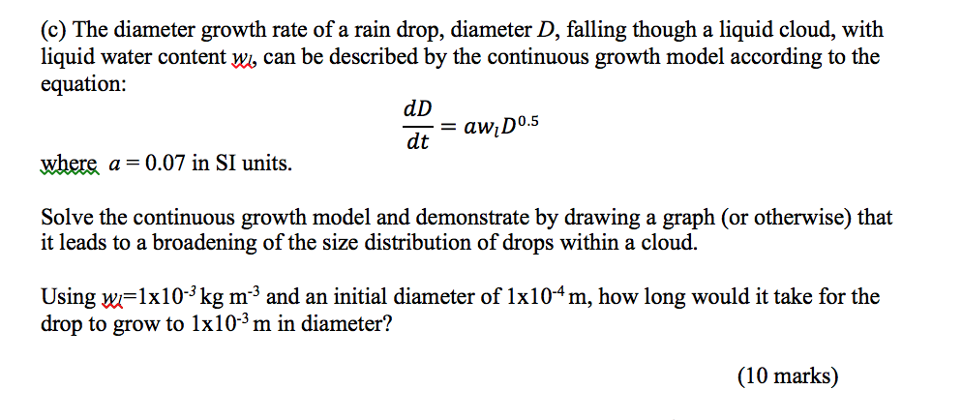
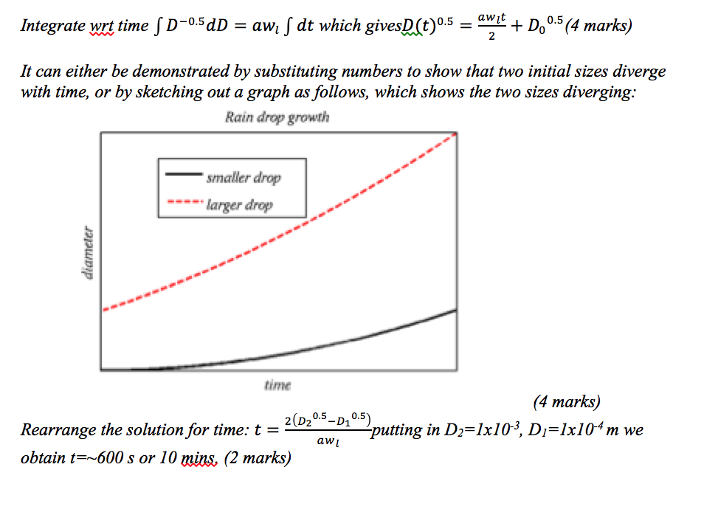

Slide 7
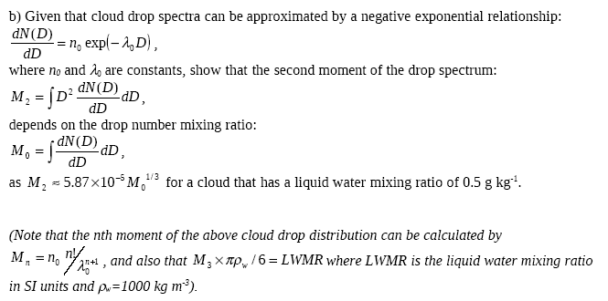
8 Marks

Slide 8
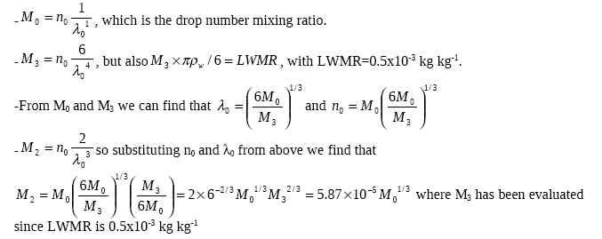

Slide 10
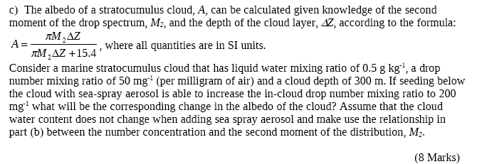

Slide 12
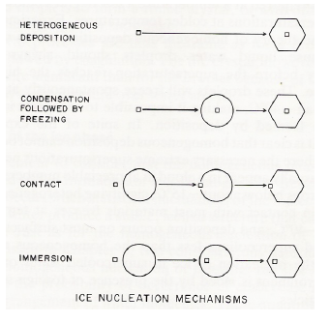
Ice nucleation
Explain the ice nucleation modes clearly and concisely…
Explain any discrepancies between the measured IN and any other ice formation pathways, referencing any equations that describe the processes.

