Slide 1
Prof. Paul Connolly
Prof. David Topping

Slide 2
Computation

Slide 7
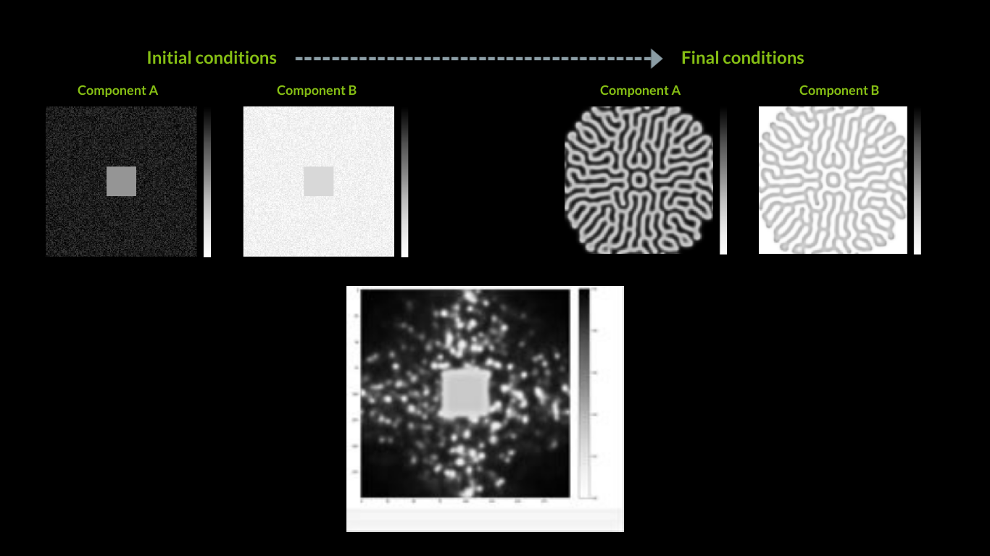

Slide 8
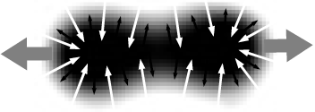
Mitosis (cell division)
Coral Growth
(branching instabilities)
https://www.karlsims.com/rd.html
https://www.karlsims.com/rd.html

