Slide 1
EART30351
Lecture 9

Slide 2
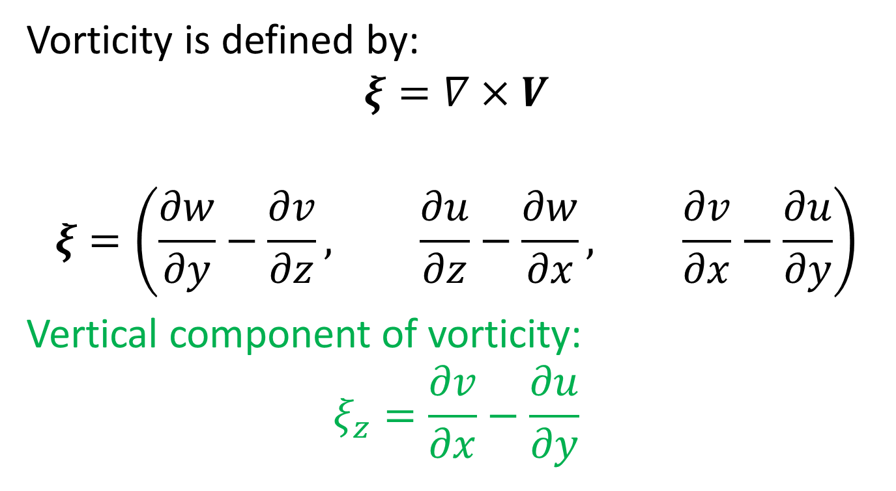
Vorticity
Vorticity is defined by:
$$ξ=∇×V$$
$$ξ=\left(\frac{∂w}{∂y}−\frac{∂v}{∂z}, \frac{∂u}{∂z}−\frac{∂w}{∂x}, \frac{∂v}{∂x}−\frac{∂u}{∂y}\right)$$
Vertical component of vorticity:
$$ξ_{z}=\frac{∂v}{∂x}−\frac{∂u}{∂y}$$

Slide 3
Vorticity
In two dimensions we can visualise ξ using a small paddle wheel. If the flow is rotational:
If the flow is sheared:
So we have rotational and shear vorticity. For synoptic-scale motion we concentrate on ξ_{z}
ξ>0
∇T
U
∇T
∇T
U
∇T
∇T
∇T
ξ<0
Streamlines of the flow
R<0
ξ<0
R>0
ξ>0

Slide 4
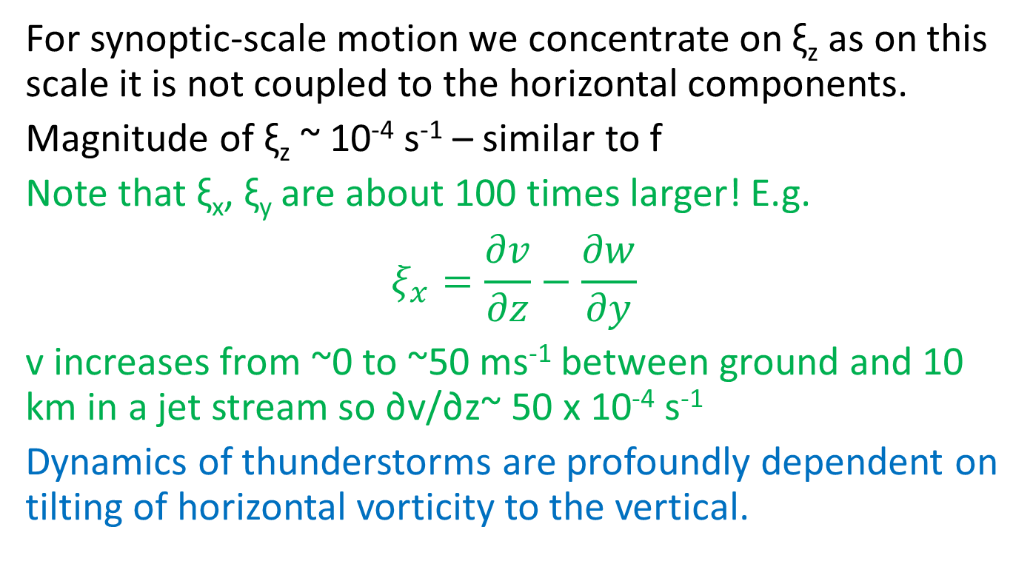
Components of vorticity
For synoptic-scale motion we concentrate on ξ_{z} as on this scale it is not coupled to the horizontal components.
Magnitude of ξ_{z} ~ 10⁻⁴ s⁻¹ – similar to f
Note that ξ_{x}, ξ_{y} are about 100 times larger! E.g.
$$ξ_{x}=\frac{∂v}{∂z}−\frac{∂w}{∂y}$$
v increases from ~0 to ~50 ms⁻¹ between ground and 10 km in a jet stream so ∂v/∂z~ 50 x 10⁻⁴ s⁻¹
Dynamics of thunderstorms are profoundly dependent on tilting of horizontal vorticity to the vertical.

Slide 5
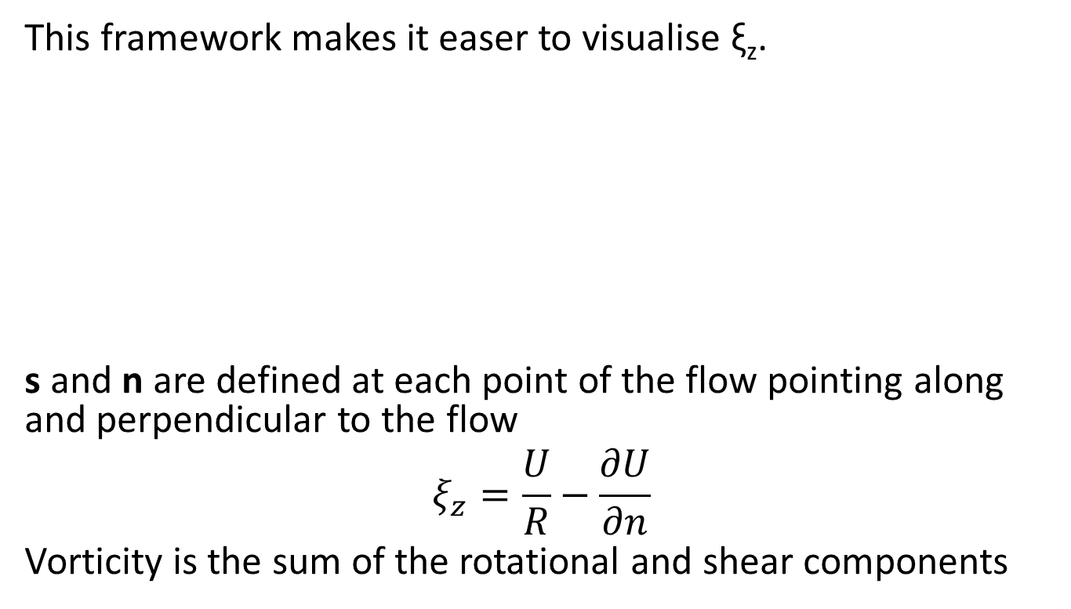
Natural coordinates
This framework makes it easer to visualise ξ_{z}.
s and n are defined at each point of the flow pointing along and perpendicular to the flow
$$ξ_{z}=\frac{U}{R}−\frac{∂U}{∂n}$$
Vorticity is the sum of the rotational and shear components
n
U
s

Slide 6

Vortex stretching
Column of incompressible fluid stretched in the vertical. Angular momentum is conserved in this process
For solid-body rotation, U=rΩ and ∂U/∂n = -∂U/∂r = -Ω. So
$$ξ_{z}=\frac{U}{R}−\frac{∂U}{∂n}=2Ω$$
Ω₂
Ω₁
h₁
r₁
h₂
r₂
Note: Ω here is the angular velocity of the cylinder, not the Earth!

Slide 7

Vortex stretching
Column of incompressible fluid stretched in the vertical. Angular momentum is conserved in this process
For solid-body rotation, U=rΩ and ∂U/∂n = -∂U/∂r = -Ω. So
$$ξ_{z}=\frac{U}{R}−\frac{∂U}{∂n}=2Ω$$
Angular momentum L about z axis
$$L=ρ∭Ur d(Volume)$$
$$L=ρh∬Ωr^{2} rdrdθ$$
$$=2πρh∫Ωr^{3}dr$$
$=\text{½}$ $πρhΩr^{4}$
Ω₂
Ω₁
h₁
r₁
h₂
r₂
Note: Ω here is the angular velocity of the cylinder, not the Earth!

Slide 8
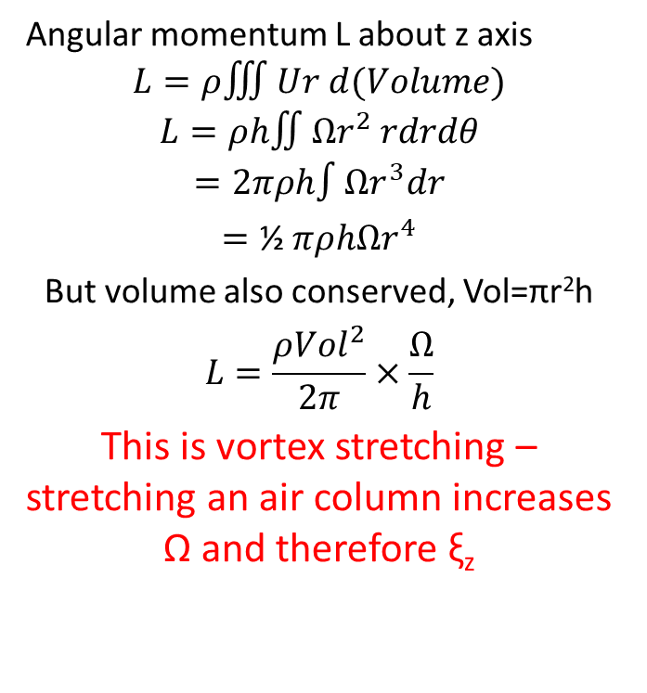
Vortex stretching
Column of incompressible fluid stretched in the vertical. Angular momentum is conserved in this process
For solid-body rotation, U=rΩ and ∂U/∂n = -∂U/∂r = -Ω. So
$$ξ_{z}=\frac{U}{R}−\frac{∂U}{∂n}=2Ω$$
Angular momentum L about z axis
$$L=ρ∭Ur d(Volume)$$
$$L=ρh∬Ωr^{2} rdrdθ$$
$$=2πρh∫Ωr^{3}dr$$
$=\text{½}$ $πρhΩr^{4}$
But volume also conserved, Vol=πr²h
$$L=\frac{ρ{Vol}^{2}}{2π}×\frac{Ω}{h}$$
This is vortex stretching – stretching an air column increases Ω and therefore ξ_{z}
Ω₂
Ω₁
h₁
r₁
h₂
r₂
Note: Ω here is the angular velocity of the cylinder, not the Earth!

Slide 9
Barotropic vorticity equation
From the basic vorticity equation:
Away from fronts, the tilting terms are small so
Here f appears as the planetary vorticity, the vorticity existing because the Earth is spinning.
ξ+f, the absolute vorticity, is the key quantity

Slide 10

Potential Vorticity
Apply the vorticity equation to:
$$\frac{d}{dt}\left(ξ+f\right)=−\left(ξ+f\right)∇.U$$
$$=\left(ξ+f\right)\frac{∂ω}{∂p}$$
Ω₂
Ω₁
p_{t}
Δp₁
Δp₂
p_{b}

Slide 11
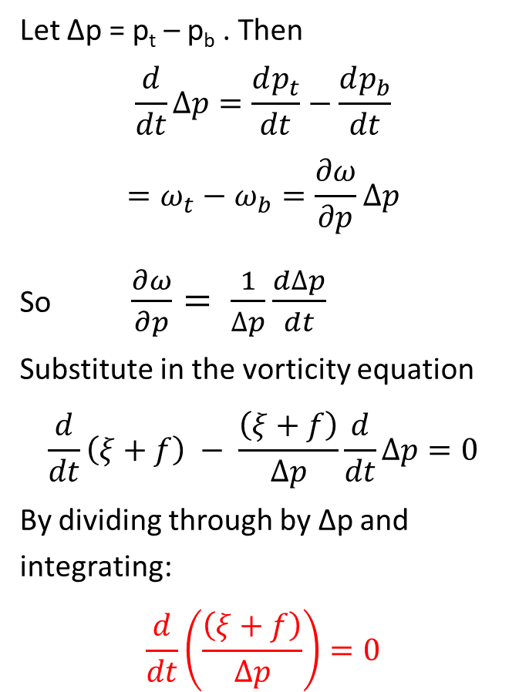
Potential Vorticity
Let Δp = p_{t} – p_{b} . Then
$$\frac{d}{dt}∆p=\frac{dp_{t}}{dt}−\frac{dp_{b}}{dt}$$
$$=ω_{t}−ω_{b}=\frac{∂ω}{∂p}∆p$$
So $\frac{∂ω}{∂p}= \frac{1}{∆p}\frac{d∆p}{dt}$
Substitute in the vorticity equation
$$\frac{d}{dt}\left(ξ+f\right) − \frac{\left(ξ+f\right)}{∆p}\frac{d}{dt}∆p=0$$
By dividing through by Δp and integrating:
$$\frac{d}{dt}\left(\frac{\left(ξ+f\right)}{∆p}\right)=0$$
Apply the vorticity equation to:
$$\frac{d}{dt}\left(ξ+f\right)=−\left(ξ+f\right)∇.U$$
$$=\left(ξ+f\right)\frac{∂ω}{∂p}$$
Ω₂
Ω₁
p_{t}
Δp₁
Δp₂
p_{b}

Slide 12
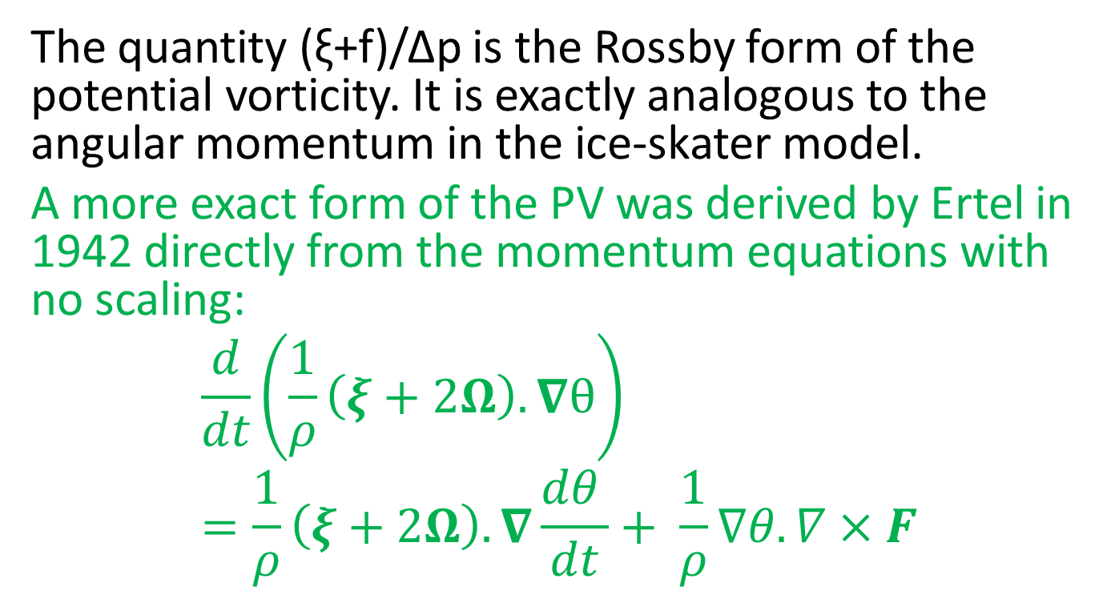
Potential vorticity 2
The quantity (ξ+f)/Δp is the Rossby form of the potential vorticity. It is exactly analogous to the angular momentum in the ice-skater model.
A more exact form of the PV was derived by Ertel in 1942 directly from the momentum equations with no scaling:
$$\frac{d}{dt}\left(\frac{1}{ρ}\left(ξ+2Ω\right).∇θ\right)=\frac{1}{ρ}\left(ξ+2Ω\right).∇\frac{dθ }{dt}+ \frac{1}{ρ}∇θ.∇×F$$

