Slide 1
EART30351
Lecture 7

Slide 2
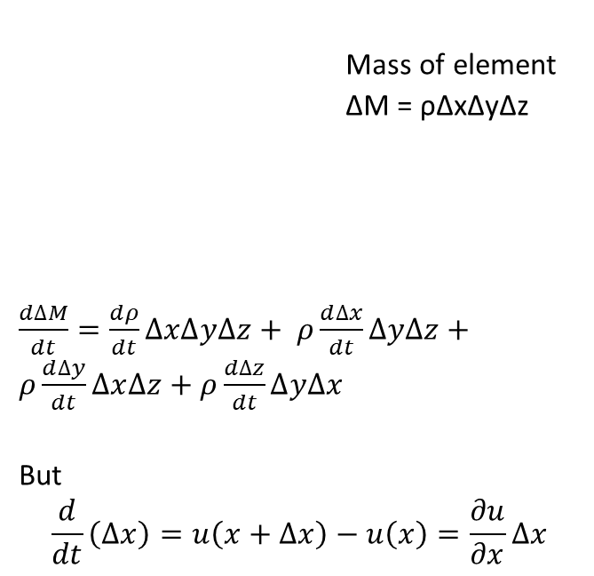
Mass continuity equation 1
Geometric coordinates
Mass of element
ΔM = ρΔxΔyΔz
$\frac{d∆M}{dt}=\frac{dρ}{dt}∆x∆y∆z+ ρ\frac{d∆x}{dt}∆y∆z+ρ\frac{d∆y}{dt}∆x∆z$ $+ ρ\frac{d∆z}{dt}∆y∆x$
But
$$\frac{d}{dt}\left(∆x\right)=u\left(x+∆x\right)−u\left(x\right)=\frac{∂u}{∂x}∆x$$
Δz
x
x+Δx
Δy
Δx

Slide 3
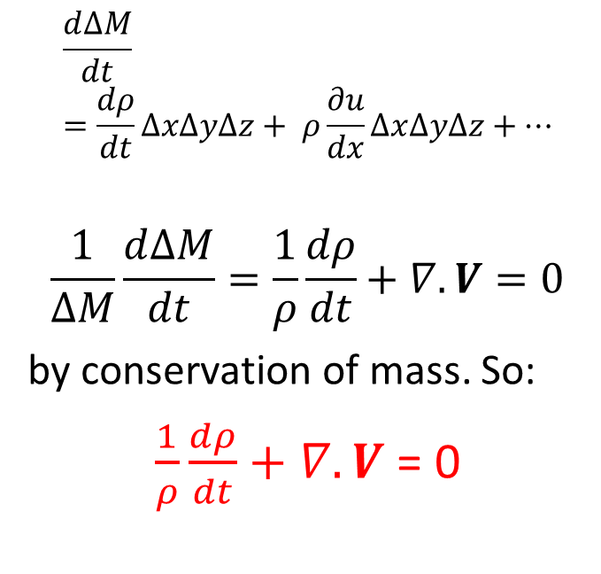
Mass continuity equation 1
Geometric coordinates
Mass of element
ΔM = ρΔxΔyΔz
$\frac{d∆M}{dt}=\frac{dρ}{dt}∆x∆y∆z+ ρ\frac{d∆x}{dt}∆y∆z+ρ\frac{d∆y}{dt}∆x∆z$ $+ ρ\frac{d∆z}{dt}∆y∆x$
But
$$\frac{d}{dt}\left(∆x\right)=u\left(x+∆x\right)−u\left(x\right)=\frac{∂u}{∂x}∆x$$
$$\frac{d∆M}{dt}=\frac{dρ}{dt}∆x∆y∆z+ ρ\frac{∂u}{dx}∆x∆y∆z+…$$
$$\frac{1}{∆M}\frac{d∆M}{dt}=\frac{1}{ρ}\frac{dρ}{dt}+∇.V=0$$
by conservation of mass. So:
$\frac{1}{ρ}\frac{dρ}{dt}+∇.V$ = 0
Δz
x
x+Δx
Δy
Δx

Slide 4
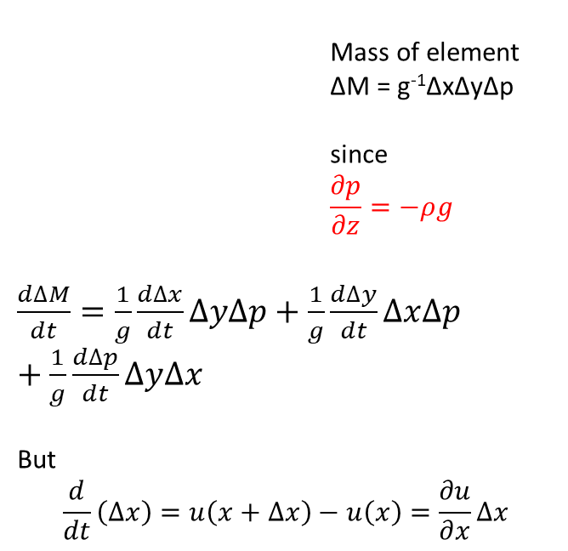
Mass continuity equation 2
Pressure coordinates
Mass of element
ΔM = g⁻¹ΔxΔyΔp
since
$$\frac{∂p}{∂z}=−ρg$$
$\frac{d∆M}{dt}=\frac{1}{g}\frac{d∆x}{dt}∆y∆p+\frac{1}{g}\frac{d∆y}{dt}∆x∆p$ $+\frac{1}{g}\frac{d∆p}{dt}∆y∆x$
But
$$\frac{d}{dt}\left(∆x\right)=u\left(x+∆x\right)−u\left(x\right)=\frac{∂u}{∂x}∆x$$
Δp
x
x+Δx
Δy
Δx

Slide 5
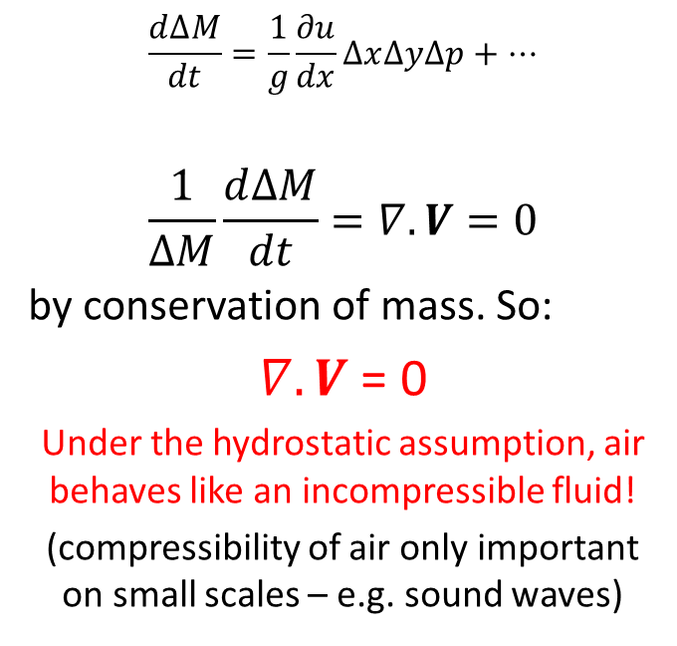
Mass continuity equation 2
Pressure coordinates
Mass of element
ΔM = g⁻¹ΔxΔyΔp
since
$$\frac{∂p}{∂z}=−ρg$$
$\frac{d∆M}{dt}=\frac{1}{g}\frac{d∆x}{dt}∆y∆p+\frac{1}{g}\frac{d∆y}{dt}∆x∆p$ $+\frac{1}{g}\frac{d∆p}{dt}∆y∆x$
But
$$\frac{d}{dt}\left(∆x\right)=u\left(x+∆x\right)−u\left(x\right)=\frac{∂u}{∂x}∆x$$
$$\frac{d∆M}{dt}=\frac{1}{g}\frac{∂u}{dx}∆x∆y∆p+…$$
$$\frac{1}{∆M}\frac{d∆M}{dt}=∇.V=0$$
by conservation of mass. So:
$∇.V$ = 0
Under the hydrostatic assumption, air behaves like an incompressible fluid!
(compressibility of air only important on small scales – e.g. sound waves)
Δp
x
x+Δx
Δy
Δx

Slide 6
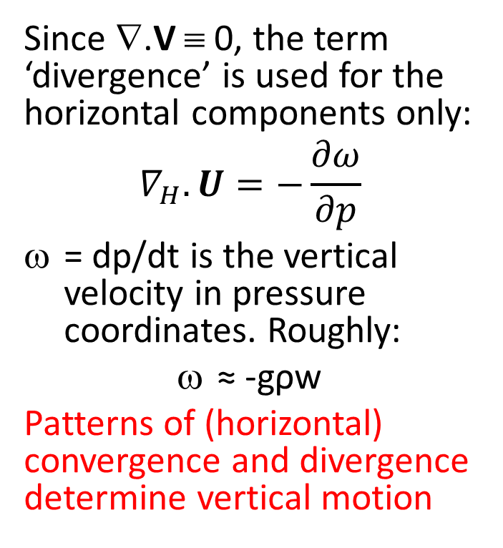
Convergence and Divergence
Since ∇.V ≡ 0, the term ‘divergence’ is used for the horizontal components only:
$$∇_{H}.U=−\frac{∂ω}{∂p}$$
= dp/dt is the vertical velocity in pressure coordinates. Roughly:
≈ -gρw
Patterns of (horizontal) convergence and divergence determine vertical motion

Slide 7
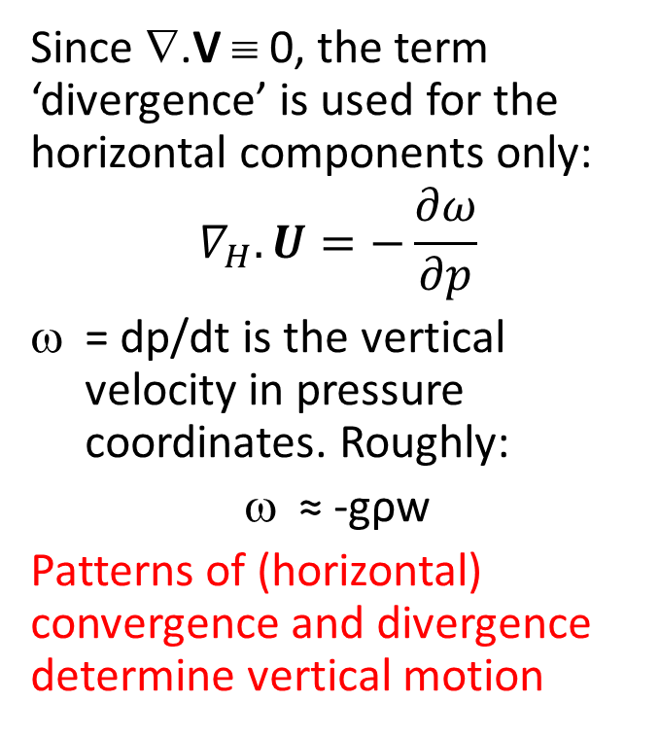
Convergence and Divergence
Since ∇.V ≡ 0, the term ‘divergence’ is used for the horizontal components only:
$$∇_{H}.U=−\frac{∂ω}{∂p}$$
= dp/dt is the vertical velocity in pressure coordinates. Roughly:
≈ -gρw
Patterns of (horizontal) convergence and divergence determine vertical motion
Weather systems are vertically coherent (300 and 700 mb charts qualitatively similar).
So, the sign of w and ω doesn’t change in the vertical
At the ground, w,ω = 0
At the tropopause w,ω ≈ 0 since stratosphere restricts vertical motion

Slide 8
Convergence-Divergence Dipoles
Positive ω (downward motion)
Negative ω (upward motion)
Trop
Trop
Convergence
∂ω/∂p > 0
∂ω/∂p < 0
Divergence
Height
Pressure
Height
Pressure
Divergence
∂ω/∂p < 0
∂ω/∂p > 0
Convergence
ω
ω
Convergence aloft means divergence below and vice versa

Slide 9
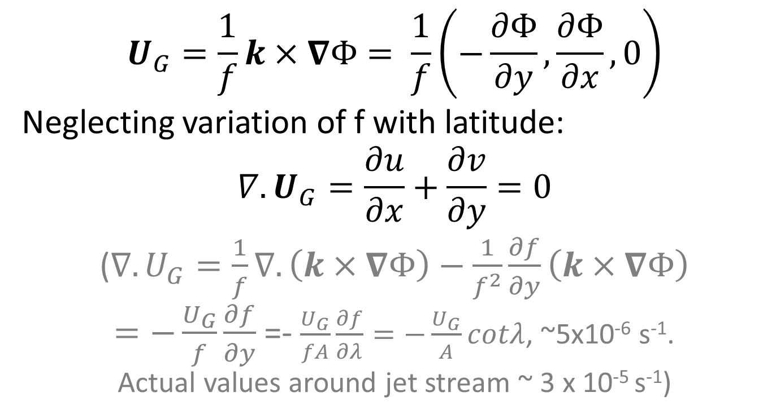
Divergence of the Geostrophic wind
$$U_{G}=\frac{1}{f}k×∇Φ= \frac{1}{f}\left(−\frac{∂Φ}{∂y},\frac{∂Φ}{∂x},0\right)$$
Neglecting variation of f with latitude:
$$∇.U_{G}=\frac{∂u}{∂x}+\frac{∂v}{∂y}=0$$
($∇.U_{G}=\frac{1}{f}∇.\left(k×∇Φ\right)−\frac{1}{f^{2}}\frac{∂f}{∂y}\left(k×∇Φ\right)$
$=−\frac{U_{G}}{f}\frac{∂f}{∂y}$ =- $\frac{U_{G}}{fA}\frac{∂f}{∂λ}=−\frac{U_{G}}{A}cotλ$, ~5x10⁻⁶ s⁻¹.
Actual values around jet stream ~ 3 x 10⁻⁵ s⁻¹)

Slide 10
Ageostrophic wind
Decompose U into:
U = U_{G} + U_{A}
Geostrophic and ageostrophic wind.
Divergence/convergence therefore depend mainly on departures from geostrophy – i.e. U_{A}

Slide 11
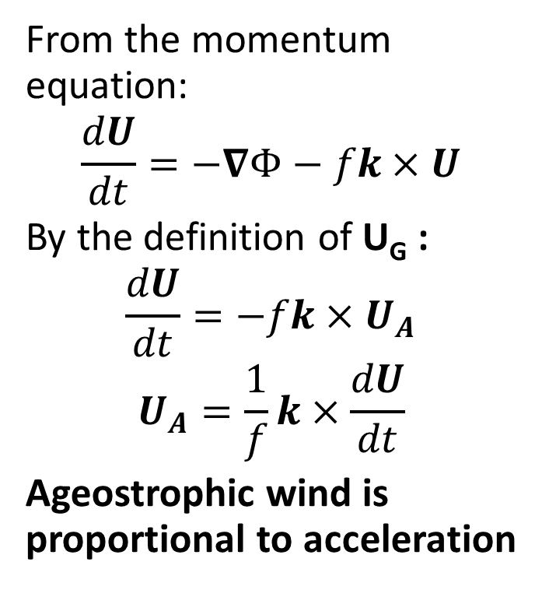
Ageostrophic wind
Decompose U into:
U = U_{G} + U_{A}
Geostrophic and ageostrophic wind.
Divergence/convergence therefore depend mainly on departures from geostrophy – i.e. U_{A}
From the momentum equation:
$$\frac{dU}{dt}=−∇Φ−fk×U$$
By the definition of U_{G} :
$$\frac{dU}{dt}=−fk×U_{A}$$
$$U_{A}=\frac{1}{f}k×\frac{dU}{dt}$$
Ageostrophic wind is proportional to acceleration

Slide 12
Ageostrophic wind around jet stream
Acceleration is greatest where wind is greatest, i.e. jet stream
U_{A} is perpendicular to the acceleration (x product)
U_{A}
accn
Jet stream accelerating from left to right (jet entrance)

Slide 13
Convergence around jet streak
Undisturbed flow, dU/dt = 0
U_{A}
C
D
dU/dt
Jet
dU/dt
C
U_{A}
D
Undisturbed flow, dU/dt = 0
Ageostrophic wind at jet entrance (LHS) points poleward. This means air ‘piles up’ on the poleward side – convergence. As this is near the tropopause it tends to force downward motion – and by symmetry we can see a quadrupole pattern

Slide 14
Dines Compensation
Tropopause
C
D
C
D
C
D
Ground
Schematic of synoptic-scale atmospheric circulation – overturning cells (showing w rather than ω vertical velocity)
Areas of vertical motion related to vertical dipoles of convergence and divergence

Slide 15
Relation to flow
Tropopause
J
J
J
H
L
H
Ground
Convergence and divergence is greatest at jet stream level: jet stream essentially drives the circulation cells.
Convergence aloft => More mass in the column of air => High pressure at surface
Divergence aloft => Less mass in the column of air => Low pressure at surface

