Slide 1
EART30351
Lecture 5

Slide 2

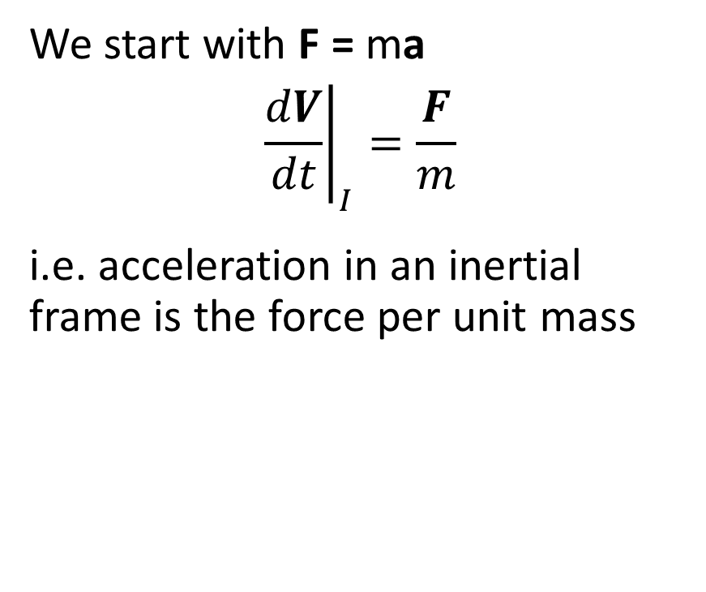
Forces on a parcel of air
We start with F = ma
$${\left.\frac{dV}{dt}\right|}_{I}=\frac{F}{m}$$
i.e. acceleration in an inertial frame is the force per unit mass
Gravitational acceleration
$$\frac{dV}{dt}=−\frac{GM_{E}}{A^{3}}A$$
A = vector from centre of Earth
M_{E} = mass of Earth
dV/dt
A

Slide 3

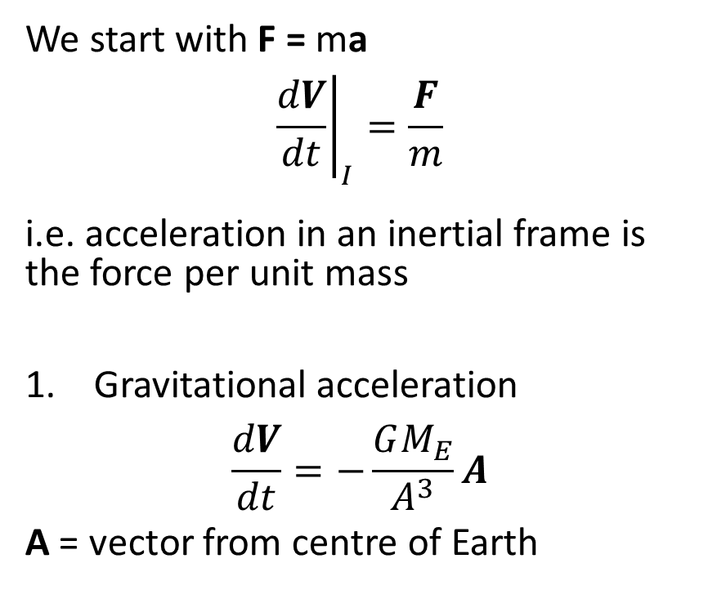
Forces on a parcel of air
We start with F = ma
$${\left.\frac{dV}{dt}\right|}_{I}=\frac{F}{m}$$
i.e. acceleration in an inertial frame is the force per unit mass
Gravitational acceleration
$$\frac{dV}{dt}=−\frac{GM_{E}}{A^{3}}A$$
A = vector from centre of Earth
2. Pressure gradient acceleration
$$Net force along x=\left\{p\left(x\right)−p\left(x+dx\right)\right\} dy dz$$
$$=−\frac{∂p}{∂x}dx dy dz$$
$$mass of air parcel= ρ dx dy dz$$
$$∴ \frac{du}{dt}=−\frac{1}{ρ}\frac{∂p}{∂x}$$
$$\frac{dV}{dt}=−\frac{1}{ρ}∇p$$
w
Pressure p
v
dz
u
dy
dx
V = (u,v,w)

Slide 4
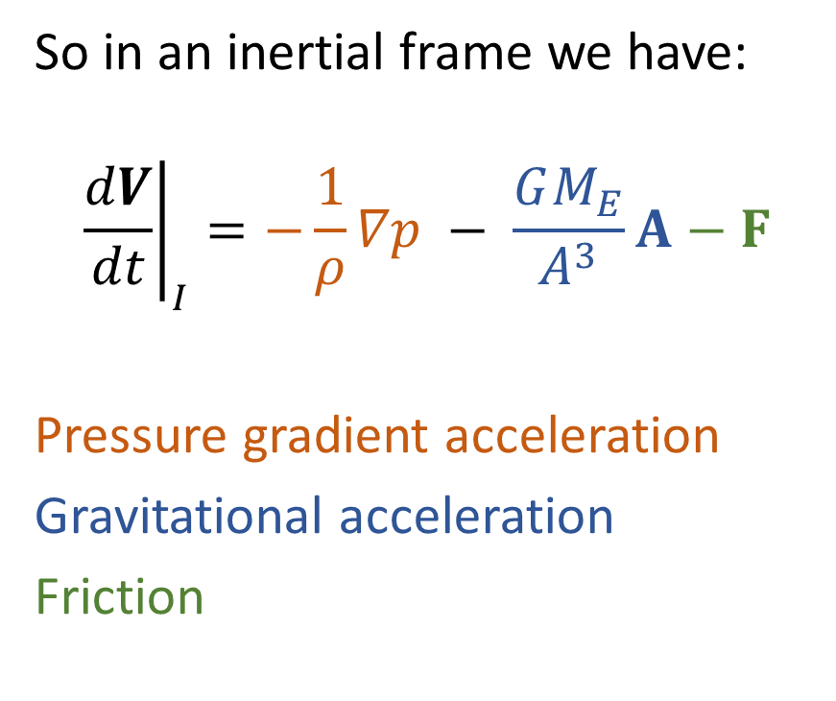
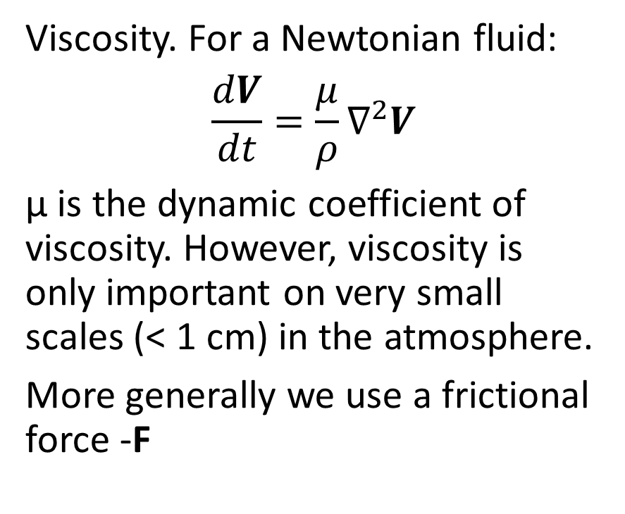
Forces on a parcel of air cont
Viscosity. For a Newtonian fluid:
$$\frac{dV}{dt}=\frac{μ}{ρ}∇^{2}V$$
μ is the dynamic coefficient of viscosity. However, viscosity is only important on very small scales (< 1 cm) in the atmosphere.
More generally we use a frictional force -F
So in an inertial frame we have:
$${\left.\frac{dV}{dt}\right|}_{I}=−\frac{1}{ρ}∇p − \frac{GM_{E}}{A^{3}}A−F$$
Pressure gradient acceleration
Gravitational acceleration
Friction

Slide 5
Lagrangian and Eulerian derivatives
F=ma applies to a parcel of air.
We call the rate of change of a quantity following the parcel the Lagrangian or material derivative, denoted by full differentials (e.g. dT/dt).
The alternative is to define a field on a grid fixed in space, and calculate Eulerian derivatives denoted by partial derivatives, e.g ∂T/∂t).
The relation between them is:
Rate of change of T at a point =
Local heating/cooling of air at that point
+
Movement of warmer or colder air over the point
Eulerian = Lagrangian + advection

Slide 6
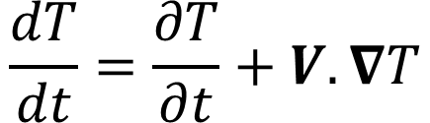

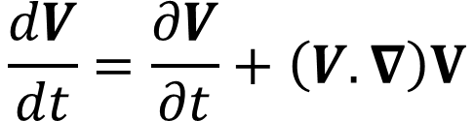
Advection
Wind is blowing colder temperatures towards P – it is advecting cold air
Rate of advection = -V.∇T (m s⁻¹ x K m⁻¹ = K s⁻¹ )
$$\frac{dT}{dt}=\frac{∂T}{∂t}+V.∇T$$
T
T+ΔT
∇T
T+2ΔT
V
For a vector field the formula generalises
P
$$\frac{dV}{dt}=\frac{∂V}{∂t}+\left(V.∇\right)V$$
The advection term is quadratic in V. This makes the momentum equation non-linear and gives rise to chaotic motion and turbulence. Advection of momentum by the flow is what makes fluid mechanics so complicated
$$\frac{∂T}{∂t}=\frac{dT}{dt}−V.∇T$$

Slide 7
Transforming to a rotating frame - Coriolis
Consider vector r in a stationary inertial frame I, with a frame R rotating about the z axis at angular velocity Ω
Ω points into the screen
-Ωxr
Ω
y_{R}
y_{I}
r
X_{R}
Ωxr
X_{I}

Slide 8
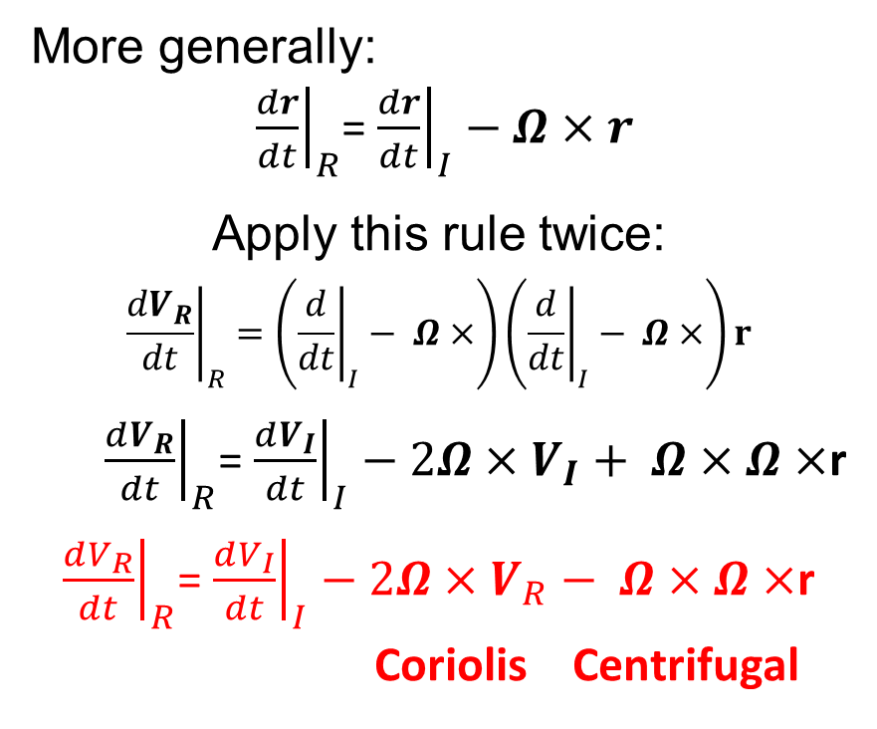

Transforming to a rotating frame
Consider vector r in an inertial frame I, with frame R rotating about the z axis at angular velocity Ω
If r is constant in I, ${\left.\frac{dr}{dt}\right|}_{R}=−Ω×r$
More generally:
${\left. \frac{dr}{dt}\right|}_{R}$= ${\left.\frac{dr}{dt}\right|}_{I}−Ω×r$
Apply this rule twice:
$${\left.\frac{dV_{R}}{dt}\right|}_{R}=\left({\left.\frac{d}{dt}\right|}_{I}− Ω×\right)\left({\left.\frac{d}{dt}\right|}_{I}− Ω×\right)r$$
${\left.\frac{dV_{R}}{dt}\right|}_{R}$= ${\left.\frac{dV_{I}}{dt}\right|}_{I}−2Ω×V_{I}+ Ω×$ $Ω×$r
${\left.\frac{dV_{R}}{dt}\right|}_{R}$= ${\left.\frac{dV_{I}}{dt}\right|}_{I}−2Ω×V_{R}− Ω×$ $Ω×$r
Coriolis Centrifugal
-Ωxr
Ω
y_{R}
y_{I}
r
X_{R}
Ωxr
X_{I}

Slide 9
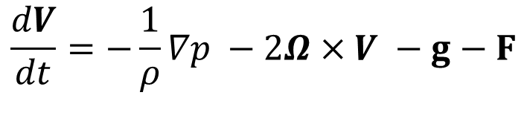
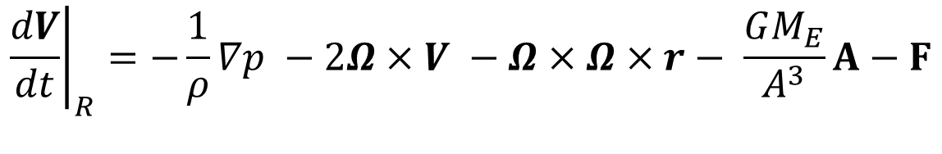
Momentum equation in a rotating frame:
$${\left.\frac{dV}{dt}\right|}_{R}=−\frac{1}{ρ}∇p −2Ω×V −Ω×Ω×r− \frac{GM_{E}}{A^{3}}A−F$$
We combine the Centrifugal and gravitational terms to get the acceleration due to gravity –g. Dropping the subscript R:
This equation applies in a frame of reference with its origin at the centre of the Earth and rotating with it.
$$\frac{dV}{dt}=−\frac{1}{ρ}∇p −2Ω×V −g−F$$

Slide 10
Local frame of reference
In this frame, x is East, y is North and z is up.
The reference frame is different at each point on the Earth’s surface but is the natural one in which to measure wind velocity, acceleration etc
Surprisingly, transforming from a frame fixed to the Earth to a local frame only introduces terms O(V²/A) to the momentum equation, where A is the radius of the Earth
From this point on we will be working in the local frame of reference

Slide 11
How big is the Coriolis force?
Ω = 2π/86400 = 7.27x10⁻⁵ rad s⁻¹
For a car, v ~ 30 ms⁻¹ so Coriolis 2Ωv ~ 0.006 ms⁻²
If car goes round corner with radius 1 km, centripetal acceleration (v²/R) ~ 1 ms⁻²
Artillery shell aimed at a point 10 km away, will be diverted by 22 m by Coriolis acceleration – enough to require a correction

Slide 12
How big is the Coriolis force?
Ω = 2π/86400 = 7.27x10⁻⁵ rad s⁻¹
For a car, v ~ 30 ms⁻¹ so Coriolis 2Ωv ~ 0.004 ms⁻²
If car goes round corner with radius 1 km, centripetal acceleration (v²/R) ~ 1 ms⁻²
Artillery shell aimed at a point 10 km away, will be diverted by 22 m by Coriolis acceleration – enough to require a correction
For air motion around high and low pressure systems, the radius of curvature is ~ 10³ km.
Typical wind speed 10 ms⁻¹
Centripetal Acceleration = 100/10⁶ = 10⁻⁴ ms⁻²
Coriolis = 2ΩV = 1.4 x 10⁻³ ms⁻²

Slide 13
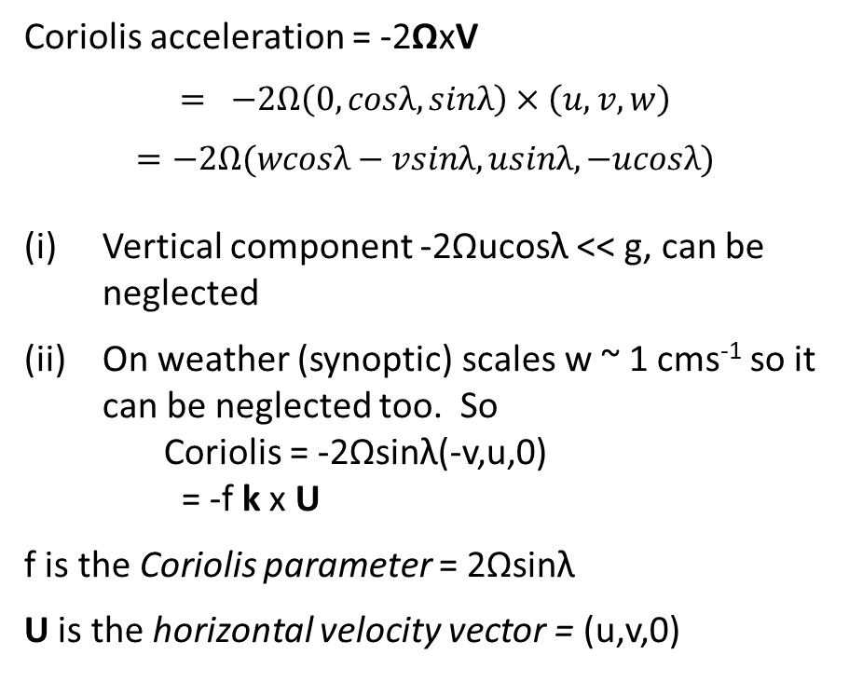
Components of the Coriolis Acceleration
Local frame of reference
Coriolis acceleration = -2ΩxV
$$= −2Ω\left(0,cosλ,sinλ\right)×\left(u,v,w\right)$$
$$=−2Ω(wcosλ−vsinλ, usinλ,−ucosλ)$$
Vertical component -2Ωucosλ << g, can be neglected
On weather (synoptic) scales w ~ 1 cms⁻¹ so it can be neglected too. So Coriolis = -2Ωsinλ(-v,u,0) = -f k x U
f is the Coriolis parameter = 2Ωsinλ
U is the horizontal velocity vector = (u,v,0)
Ω
j
k
k and j are unit vectors up and northward at P
Ω has components Ω_{k} and Ω_{j} along k and j
P
λ
Ω_{j} = Ωcosλ, Ω_{k} = Ωsinλ
where λ is latitude
Local frame of reference

Slide 14
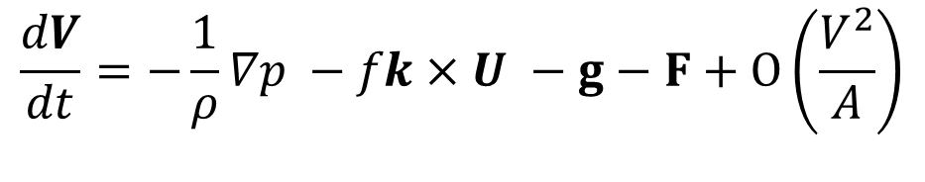
Final version of the momentum equation
In local frame of reference:
We will see next time how this equation can be simplified.
$$\frac{dV}{dt}=−\frac{1}{ρ}∇p −fk×U −g−F+O\left(\frac{V^{2}}{A}\right)$$

