Slide 1
EART30351
Lecture 3

Slide 2
Moisture in the atmosphere
Mass mixing ratio w, gkg⁻¹
Volume mixing ratio x, ppmv w = εx where ε = 18/29 = 0.622
Vapour pressure, mb. e = n_{w} kT (n_{w} = no. water molecules m⁻³)
Dew Point T_{D}, K. Temperature at which a parcel of air cooled at constant pressure reaches saturation. e = e_{s}(T_{D})

Slide 3
Moisture in the atmosphere
Mass mixing ratio w, gkg⁻¹
Volume mixing ratio x, ppmv w = εx where ε = 18/29 = 0.622
Vapour pressure, mb. e = n_{w} kT (n_{w} = no. water molecules m⁻³)
Dew Point T_{D}, K. Temperature at which a parcel of air cooled at constant pressure reaches saturation. e = e_{s}(T_{D})
Wet bulb temperature, T_{w}, K. Temperature reached at saturation when water vapour is evaporated into an air parcel, with no extra heat added.
Relative humidity, % RH = 100 e/e_{s}(T)
All these quantities are used in atmospheric physics!

Slide 4
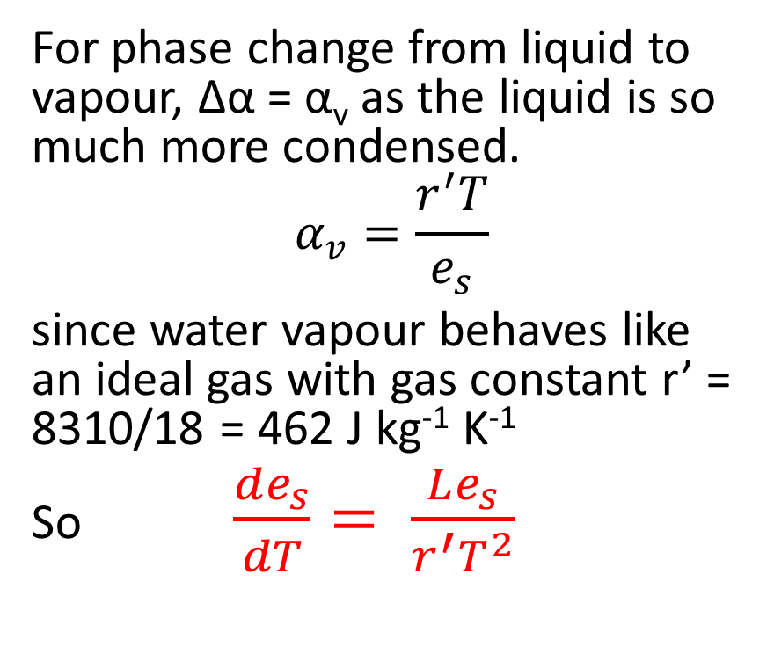
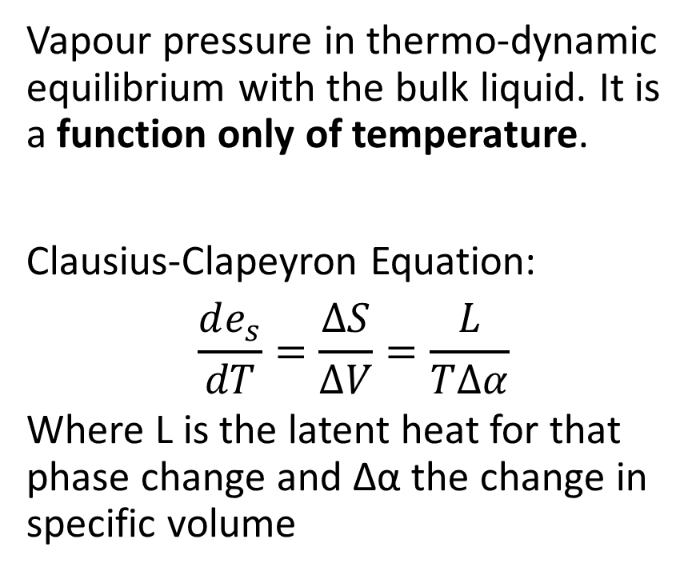
Saturated Vapour pressure, e_{s}
Vapour pressure in thermo-dynamic equilibrium with the bulk liquid. It is a function only of temperature.
Clausius-Clapeyron Equation:
$$\frac{de_{s}}{dT}=\frac{∆S}{∆V}=\frac{L}{T∆α}$$
Where L is the latent heat for that phase change and Δα the change in specific volume
For phase change from liquid to vapour, Δα = α_{v} as the liquid is so much more condensed.
$$α_{v}=\frac{r^{′}T}{e_{s}}$$
since water vapour behaves like an ideal gas with gas constant r’ = 8310/18 = 462 J kg⁻¹ K⁻¹
So $\frac{de_{s}}{dT}= \frac{Le_{s}}{r^{′}T^{2}}$

Slide 5
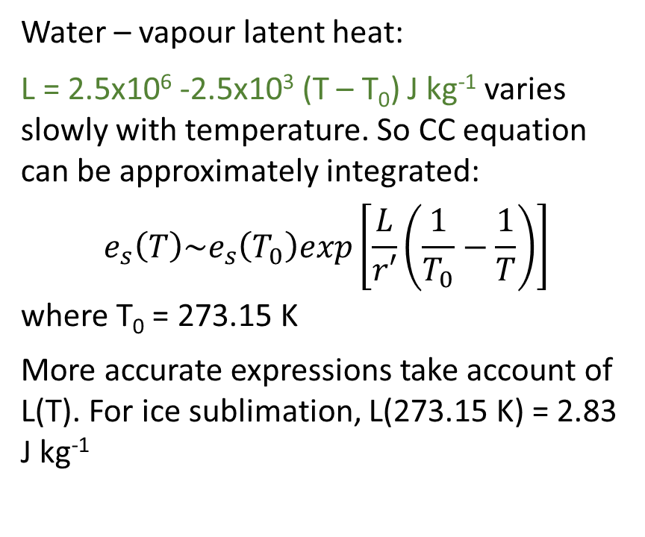
Solution of Clausius-Clapeyron equation
Water – vapour latent heat:
L = 2.5x10⁶ -2.5x10³ (T – T₀) J kg⁻¹ varies slowly with temperature. So CC equation can be approximately integrated:
$$e_{s}\left(T\right)\sim e_{s}\left(T_{0}\right)exp\left[\frac{L}{r′}\left(\frac{1}{T_{0}}−\frac{1}{T}\right)\right]$$
where T₀ = 273.15 K
More accurate expressions take account of L(T). For ice sublimation, L(273.15 K) = 2.83 J kg⁻¹

Slide 6
Supercooled water
Water can exist in liquid form in clouds down to -37°C. Liquid drops below 0°C are supercooled: ice particles will grow at the expense of the liquid drops if nucleated.
This is the Bergeron-Findeisen mechanism for generating snow and then raindrops.

Slide 7
Effect of latent heating
Latent heat of evaporation of water (or sublimation of ice) is very large and dominates atmospheric thermodynamics.
Ascending air cools more slowly when it saturates, and so remains more buoyant
Evaporating precipitation cools the air and causes downdraughts

Slide 8
Effect of latent heating
Latent heat of evaporation of water (or sublimation of ice) is very large and dominates atmospheric thermodynamics.
Ascending air cools more slowly when it saturates, and so remains more buoyant
Evaporating precipitation cools the air and causes downdraughts
Change of phase adds or subtracts heat to a parcel of air:
dQ = -Ldw
where w = mass mixing ratio of vapour
Thermodynamic equation:
dU = c_{v}dT = -Ldw – pdV becomes:
c_{p}dT = -Ldw +αdp
Condensation, Δw < 0
Heat released, ΔQ >0

Slide 9
Example: calculation of wet bulb temperature.
Suppose we start with air at 1000 mb, 20°C with 50% relative humidity.
From the graph opposite, e_{s} at 20°C is 23.2 mb. Therefore e for the parcel is 11.6 mb (50% of e_{s}).
As water evaporates, the air cools due to the latent heat of evaporation which is LΔw J kg⁻¹:
c_{p}ΔT = -LΔw = -LεΔx = -LεΔe/p
Here w is the mass mixing ratio, x the volume mixing ratio, ε=18/29 = 0.62, and x=e/p by definition
This gives a linear relation between e and T:
e = 11.6 – 0.64(T-20)
with e in mb (1 mb = 100 Pa) and T in °C
The wet bulb temperature is that when the air becomes saturated and can cool no longer. The SVP curve was calculated using the Magnus equation.

Slide 10
Saturated adiabatic lapse rate
Can calculate a pseudo-adiabatic lapse rate from the thermodynamic equation (see handout), if we assume water droplets have no specific heat capacity.
Formula is very cumbersome so to solve it we use graphical methods: the tephigram
Saturated Adiabatic Lapse Rate, SALR
ΔT due to L
z
DALR = 10 K km⁻¹
T

