Slide 1
EART30351 lecture 1

Slide 2
Purpose and scope of first half of module:
Thermodynamics of Air. Effect of moisture. Stability and convection
Basic dynamics – forces on a parcel of air, governing fluid equations and simple analytical solutions
Vorticity in the atmosphere
Along the way we will apply the concepts learnt to the weather on the day, by examining weather maps on line
Eventually you will learn to interpret these maps for yourselves!

Slide 3
Equation of state 1
The usual form of this equation for a given gaseous system is
pV = nRT
where R = 8310 J kmol⁻¹ K⁻¹
This is inconvenient as V and n are the volume and number of kmoles of gas in the system: they are extrinsic variables.
In atmospheric science we replace V and n by intrinsic, or specific variables:
Volume and number of kmoles per unit mass.

Slide 4
Specific quantities
V becomes α, the volume per unit mass.
α = 1/ρ
where ρ is the density (mass per unit volume)
1 mole of gas contains N_{A} molecules, where N_{A} = 6.022 x 10²³ mol⁻¹
1 kmol of gas contains 1000N_{A} = 6.022 x 10²⁶ molecules
Each molecule has mass MW x amu kg where MW is the relative molecular weight and amu = 1.66 x 10⁻²⁷ kg.
So, 1 kmole of gas contains 1000N_{a}x MW x amu kg = MW kg, so
Number of kmoles per unit mass = 1/MW

Slide 5
Equation of state 2
The ideal gas law becomes
p = ρrT or pα=rT
where r = R/MW.
For dry air, MW = 29 and r = 286 J kg⁻¹ K⁻¹
I will also use in this course the gas constant for water vapour,
r’=R/18 = 462 J kg⁻¹ K⁻¹

Slide 6
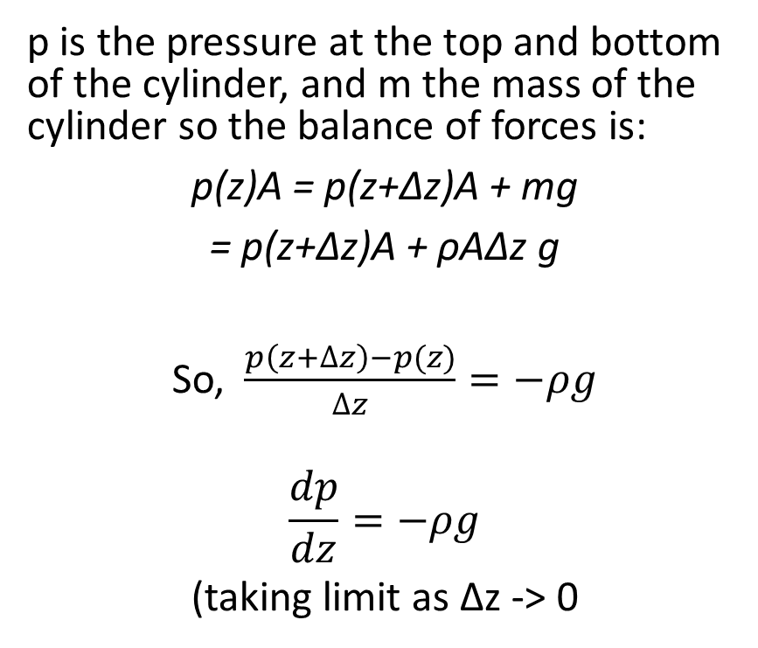
Hydrostatic equation 1
This is a fundamental equation describing the decrease of pressure with height for a fluid in a gravitational field.
p is the pressure at the top and bottom of the cylinder, and m the mass of the cylinder so the balance of forces is:
p(z)A = p(z+Δz)A + mg
= p(z+Δz)A + ρAΔz g
So, $\frac{p\left(z+∆z\right)−p(z)}{∆z}=−ρg$
$$\frac{dp}{dz}=−ρg$$
(taking limit as Δz -> 0
p(z + Δz)
z + Δz
Area A
mg
z
p(z)

Slide 7
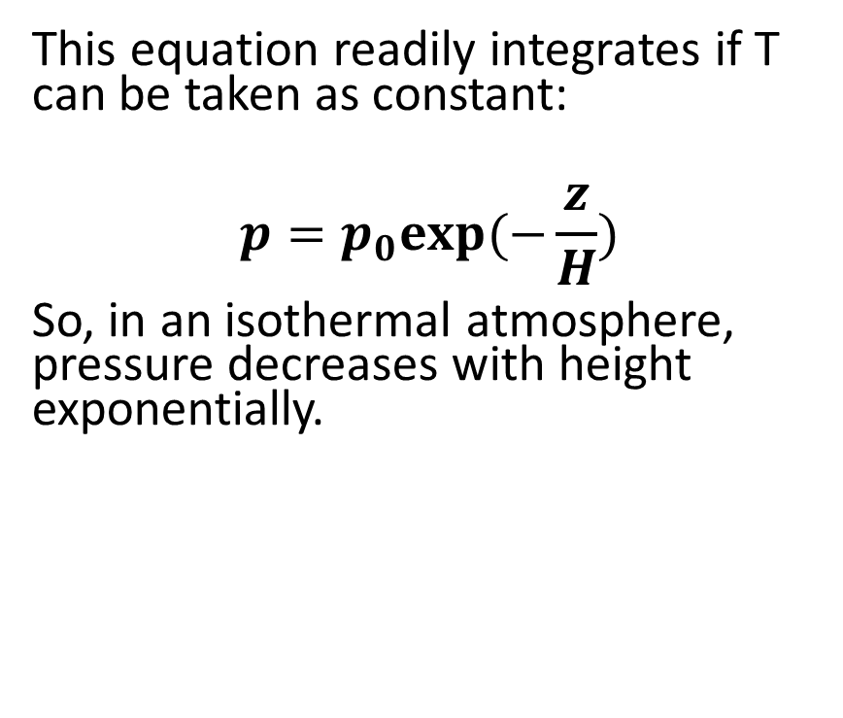
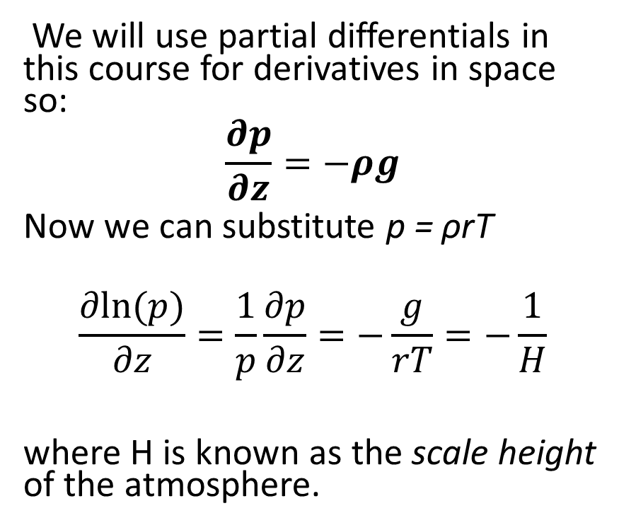
Hydrostatic equation 2
We will use partial differentials in this course for derivatives in space so:
$$\frac{∂p}{∂z}=−ρg$$
Now we can substitute p = ρrT
$$\frac{∂ln⁡(p)}{∂z}=\frac{1}{p}\frac{∂p}{∂z}=−\frac{g}{rT}=−\frac{1}{H}$$
where H is known as the scale height of the atmosphere.
This equation readily integrates if T can be taken as constant:
$$p=p_{0}exp⁡(−\frac{z}{H})$$
So, in an isothermal atmosphere, pressure decreases with height exponentially.

Slide 8
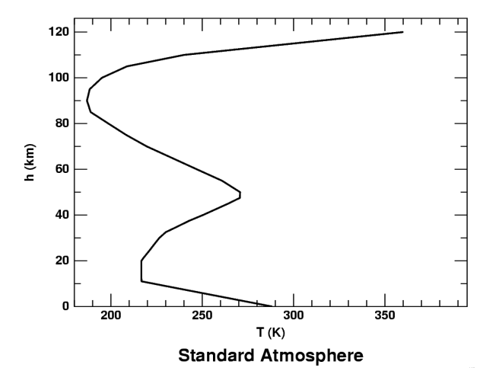
Scale height
Atmospheric temperature varies in the vertical between 200 and 300 K for the most part.
So H varies between 5.72 km and 8.58 km = roughly 7 ± 1.5 km
Approximate pressure at different heights:
Thermosphere
Mesopause
Mesosphere
Stratopause
Stratosphere
Height, km | Pressure, mb
0 (surface) | 1000
5 | 500
9 | 300
12 | 200
16 | 100
Tropopause
Troposphere

Slide 9
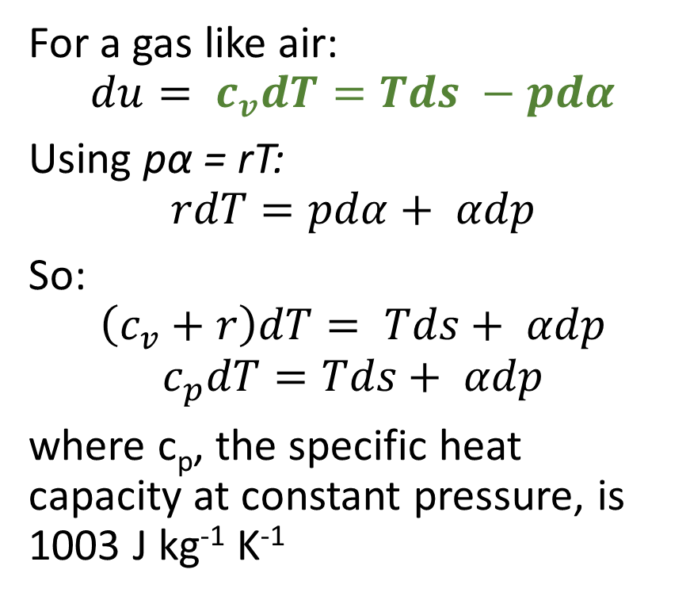
Laws of Thermodynamics
For a gas like air:
$$du= c_{v}dT=Tds −pdα$$
Using pα = rT:
$$rdT=pdα+ αdp$$
So:
$$\left(c_{v}+r\right)dT= Tds+ αdp$$
$$c_{p}dT=Tds+ αdp$$
where c_{p}, the specific heat capacity at constant pressure, is 1003 J kg⁻¹ K⁻¹

Slide 10
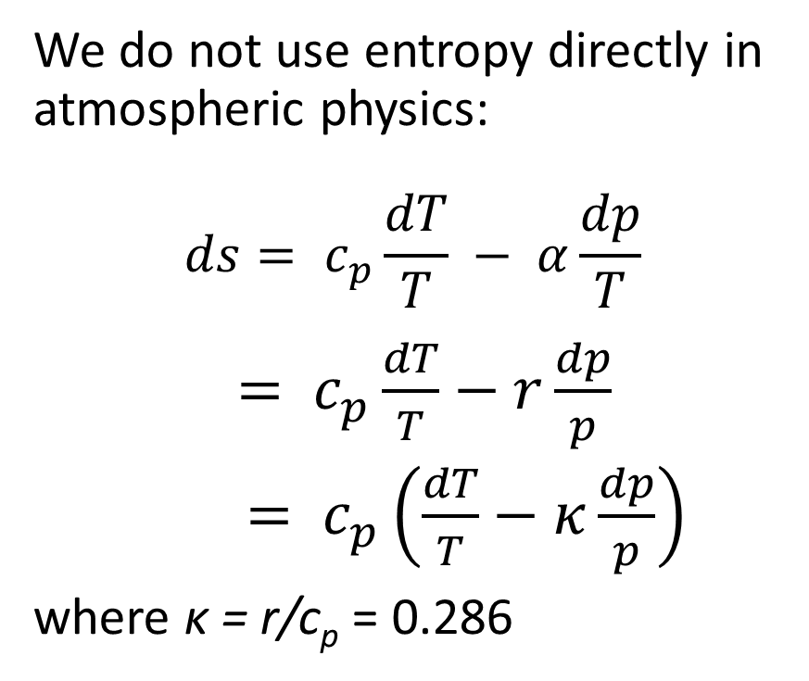
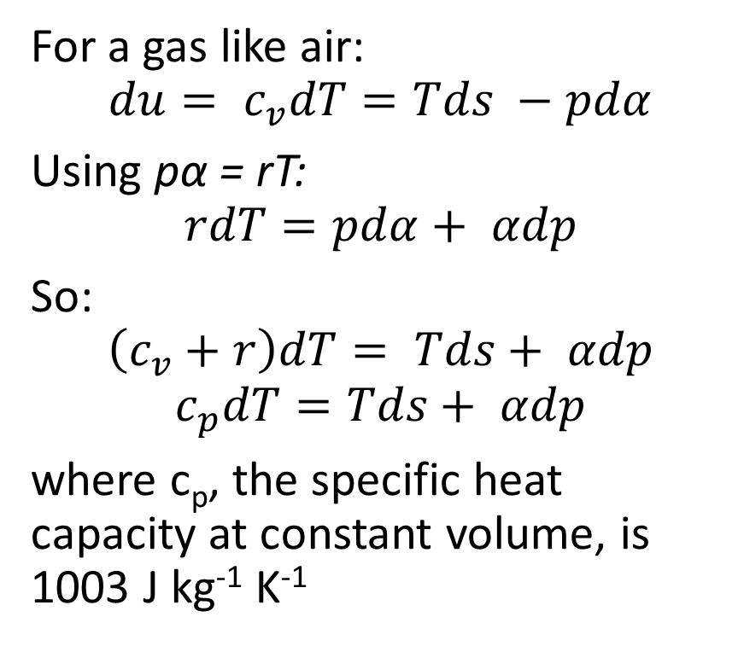
Laws of Thermodynamics
For a gas like air:
$$du= c_{v}dT=Tds −pdα$$
Using pα = rT:
$$rdT=pdα+ αdp$$
So:
$$\left(c_{v}+r\right)dT= Tds+ αdp$$
$$c_{p}dT=Tds+ αdp$$
where c_{p}, the specific heat capacity at constant volume, is 1003 J kg⁻¹ K⁻¹
We do not use entropy directly in atmospheric physics:
$$ds= c_{p}\frac{dT}{T} − α\frac{dp}{T}$$
$= c_{p}\frac{dT}{T}−r\frac{dp}{p}$
$= c_{p}\left(\frac{dT}{T}−κ\frac{dp}{p}\right)$
where κ = r/c_{p} = 0.286

Slide 11
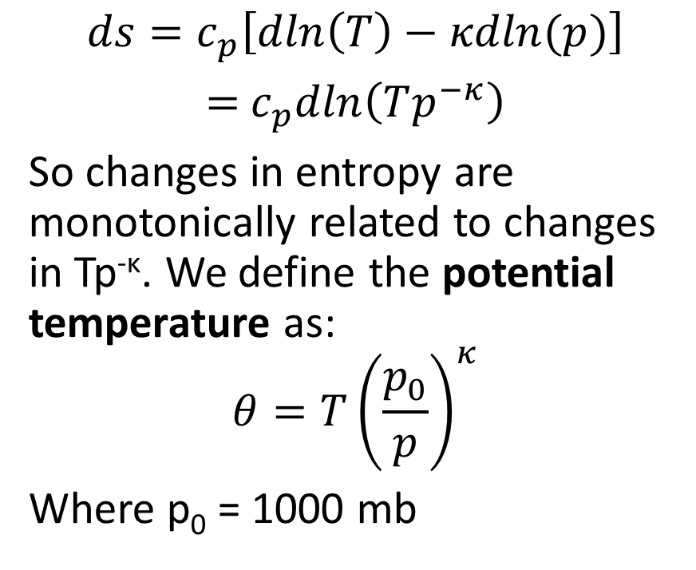
Potential temperature
$$ds=c_{p}\left[dln\left(T\right)−κdln(p)\right]$$
$=$ $c_{p}dln\left(Tp^{−κ}\right)$
So changes in entropy are monotonically related to changes in Tp^{-κ}. We define the potential temperature as:
$$θ=T{\left(\frac{p_{0}}{p}\right)}^{κ}$$
Where p₀ = 1000 mb
Adiabatic changes to a gas are those that preserve entropy – and so adiabatic means constant θ
θ is the temperature a parcel of air will have if it is brought adiabatically down to the surface (1000 mb) from a pressure p.

Slide 12
Why potential temperature?
The thermodynamic state of a parcel of air is defined fully by any two of p, T, ρ and S. Of the four, S varies most slowly so is the closest to being conserved
Use of θ rather than S is historical, but ubiquitous in atmospheric science
Processes that change entropy (θ):
Radiation. Absorption and emission of UV, visible and IR radiation
Change of phase of water – condensation, evaporation, melting, freezing
Contact with the Earth’s surface (conduction)

