Slide 1
SEND: a System for Electronic Notification and Documentation of vital sign observations. User-centred design for optimum development, deployment and evidence based care
Julia Knight, David Wong

Slide 2
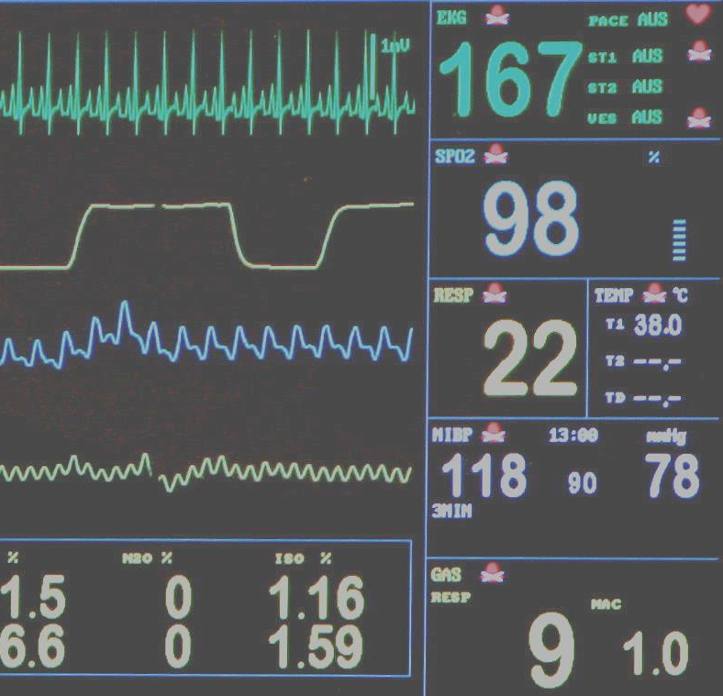
The Problem
20,000 preventable deaths each year
May be prevented by earlier intervention
Early Warning Scores

Slide 3
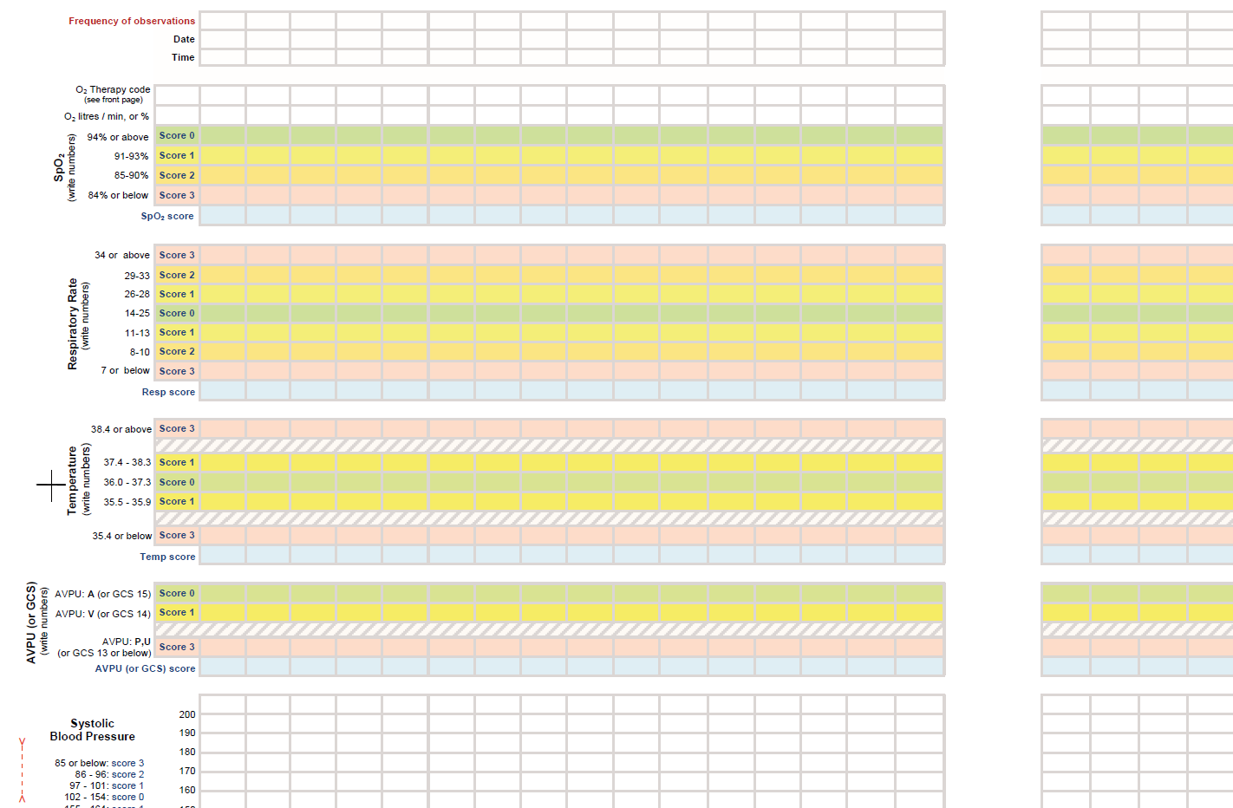

Slide 4
SpO2 score: 0
Resp score: 1
Temp score: 1
GCS score: 0
Total: 2
99
0
27
1
37.4
1
A
0

Slide 5
Fast Data Entry
Vital sign data should be documented at least as fast as on paper

Slide 6
Easy Data Review
The Right Data shared with the Right People

Slide 7
Patient Safety
Positive Patient ID via wristband barcodes

Slide 8
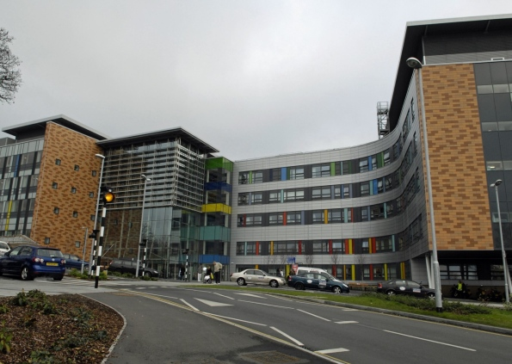
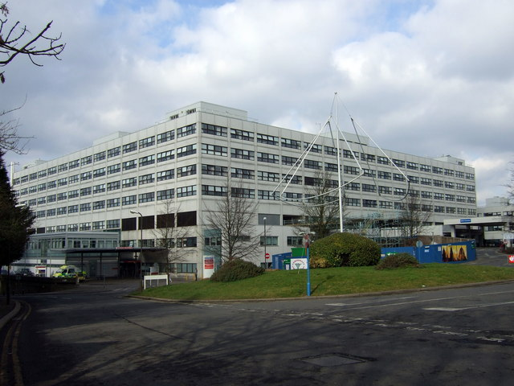
Towards Electronic Systems
Where are they?
Notes:
Why Electronic?

Slide 9
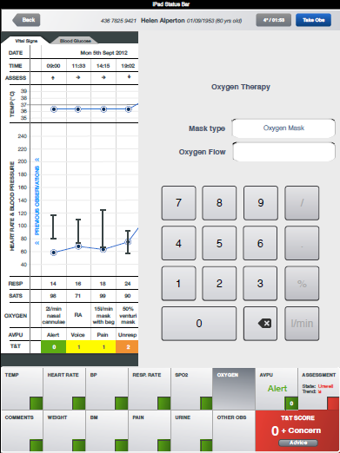
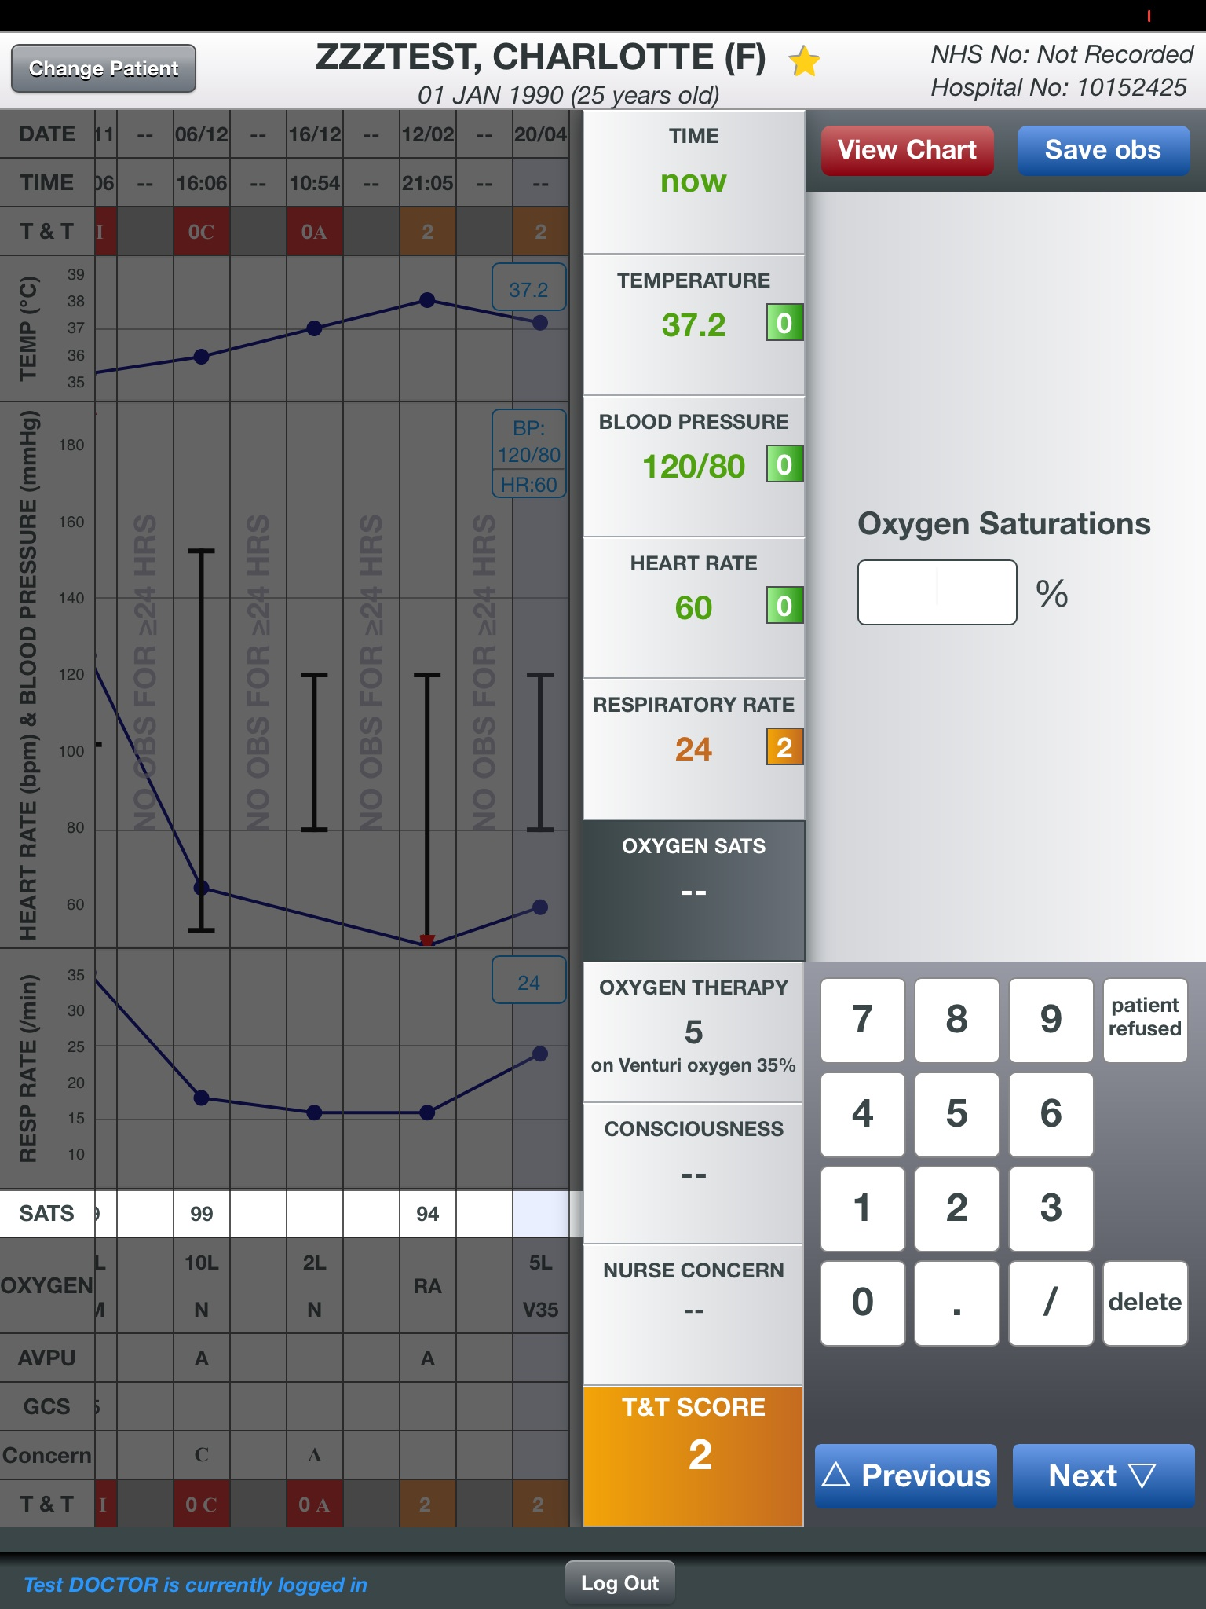
The SEND Design Process
Analyse current clinical process
Assess market-leading systems
Initial prototyping
Redesign
Develop initial specification
Develop User stories
Pilot testing
(2 Wards)
Measurement and mitigation of errors
Amend User Stories
Develop evidence base for e-observations
Barriers and enablers of successful intervention
Notes:
Why not an existing system?

Slide 10
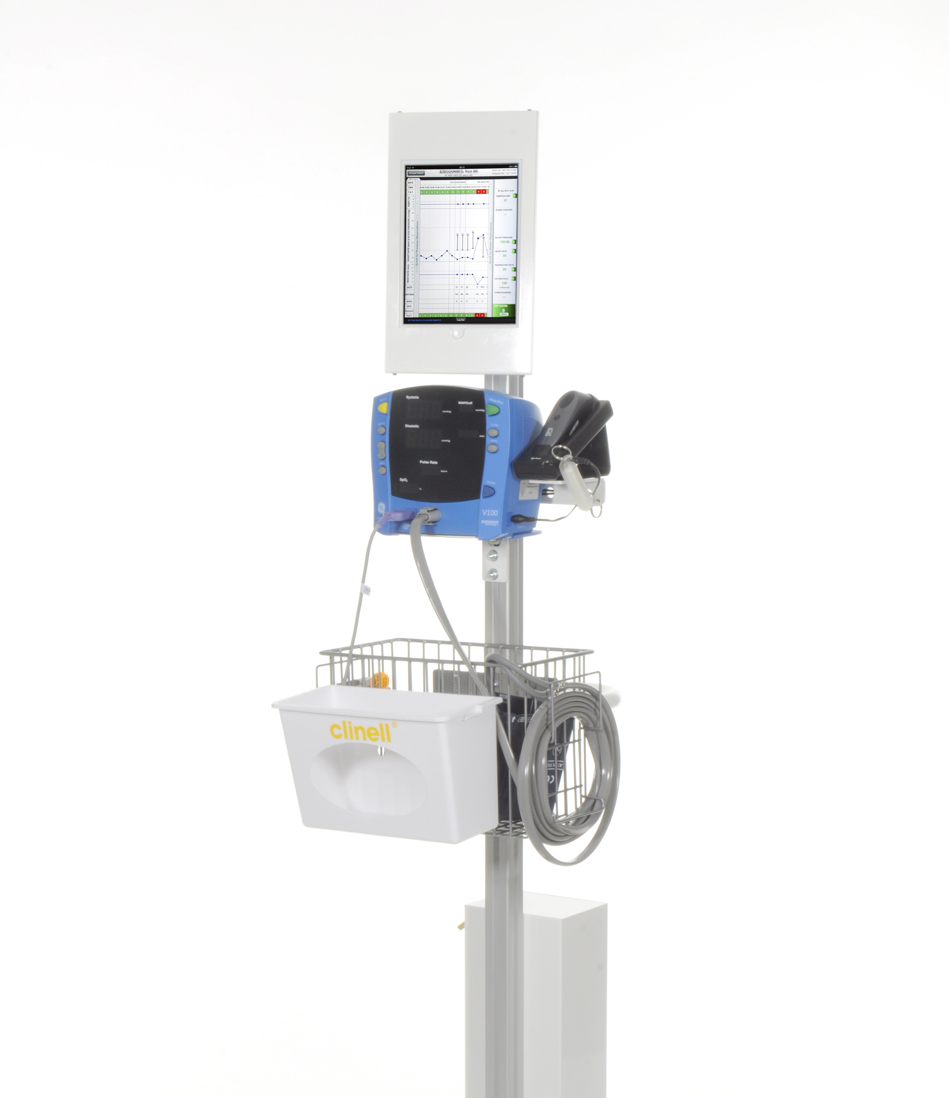
SEND

Slide 11
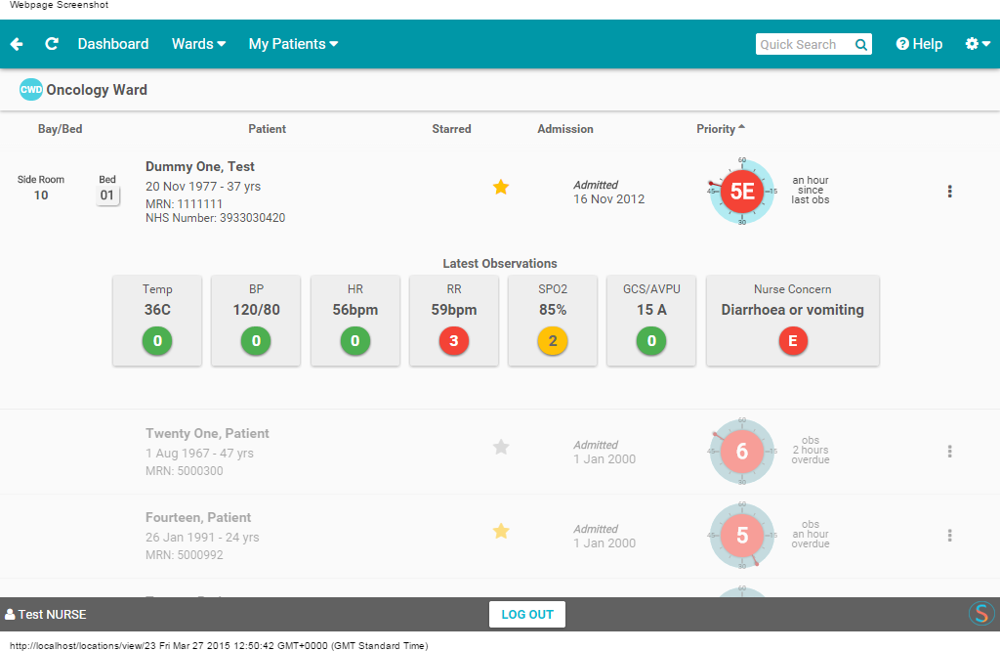
Ward Review
SEND displays lists of patients in each ward

Slide 12
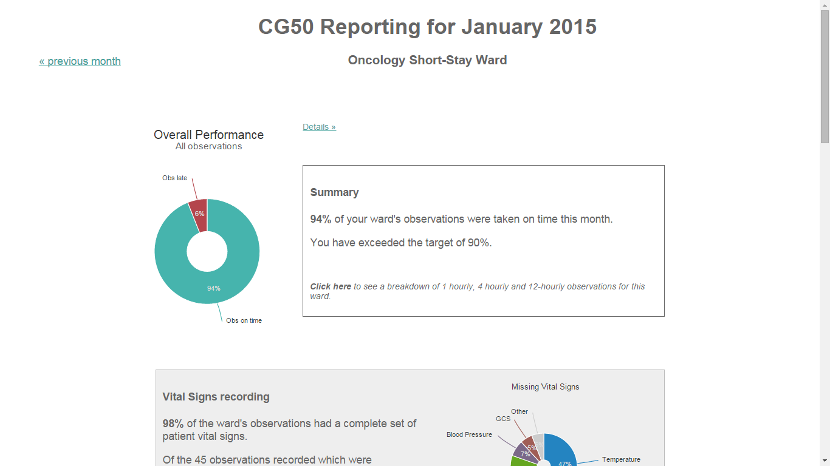
Automatic Feedback
SEND displays near real-time information on observation timeliness and completion for each ward

Slide 13
Structured implementation strategy
5 weeks
Critical mass training
Making change with clinical staff

Slide 14
900,000+
Vital Signs Recorded Using SEND

Slide 15
1 hospital
1200+
1000+ users
3 more planned
Observation Sets Per Day
Nurses, Doctors and other Allied Health Professionals

Slide 16
One of the most amazing things that I have had the pleasure in being involved in
- Senior Nurse, Churchill Hospital OUH NHS Trust

Slide 17
There is a large gap between the postulated and empirically demonstrated benefits of e-Health technologies
-Black et al. The Impact of e-Health on the Quality and Safety of Health Care: A Systematic Overview

Slide 18
iSEND
Does the introduction of SEND bring the nurse back to the bedside more promptly following a high EWS?
Step Wedge
All Patients

Slide 19
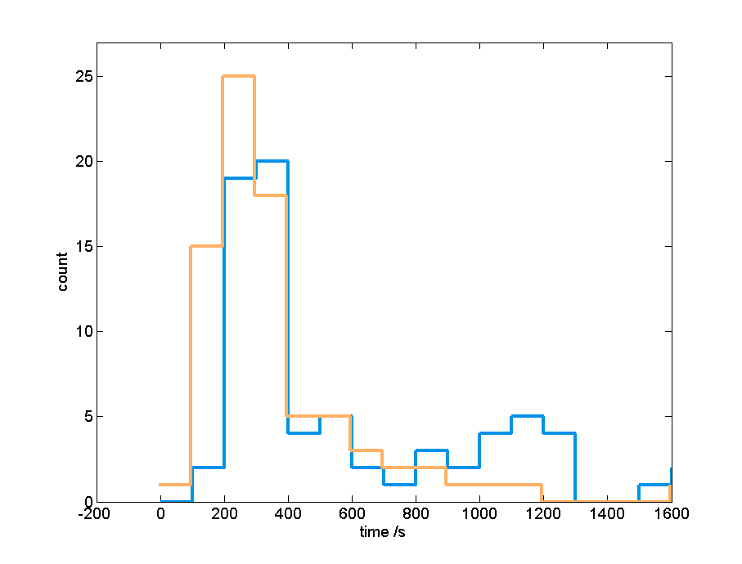
Technology Implementation Study (TIE)
Time-and-Motion Study
3-minute time saving per Observation Set
77.8 System Useability Score - High Useability

Slide 20
e-Health Innovation

Slide 21
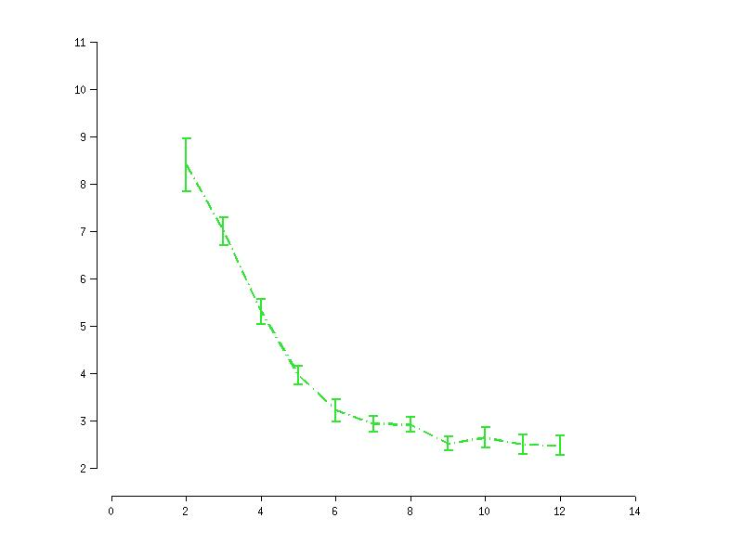
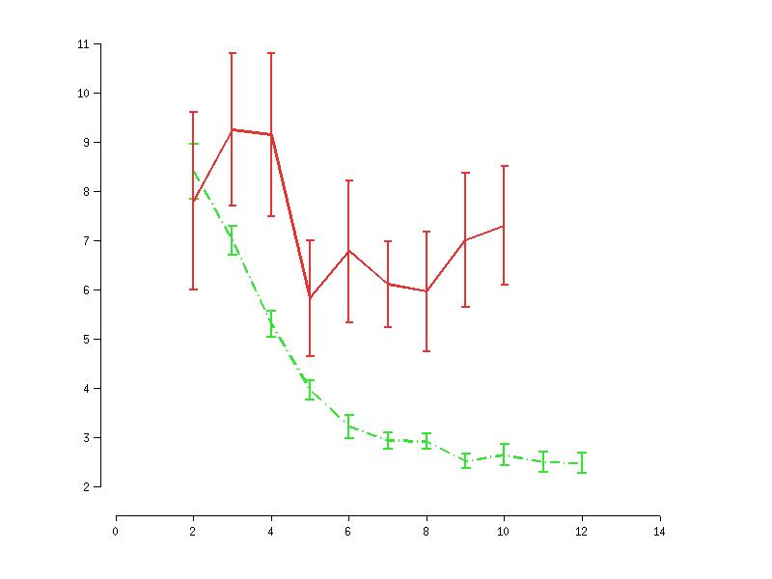
Trend Information
Age
“Uncomplicated “ patients (160): discharged home within 30 days
“Abnormal” patients (23):
(re-)admitted to ICU or died on the ward
RR variability (breaths per min.)
Post-operative day

Slide 22
Cohort and Personalised Models

Slide 23
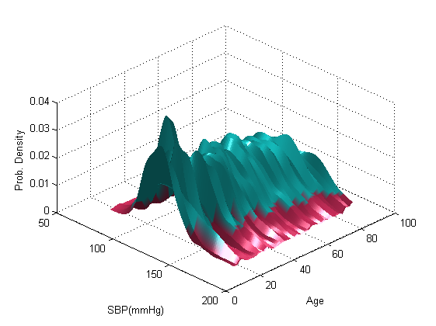
Cohort and Personalised Models

Slide 25
Acknowledgment
Oxford Biomedical Research Centre
Safer Hospital Safer Wards
Software Engineers
Clinicians
Human Factors
Medical Engineers/ HI

