Slide 1
Using the lavaan package R-thritis 21.5.21
James Gwinnutt

Slide 2
Outline
Motivation
Lavaan package
Path analysis
Confirmatory factor analysis
Structural Equation Modelling

Slide 3
Motivation
Often want to investigate concepts that cannot be directly measured
Latent variables – use a set of observed variables to define a latent variable
Then we can analyse these variables in the normal way (i.e. regression analysis)
Intelligence
Empathy

Slide 4
lavaan
lavaan = latent variable analysis
Step 1 – define a model
Step 2 – fit model with data
Step 3 – inspect the output of the model

Slide 5
lavaan [2]
Defining a model – pretty much just a set of regression models
Y ~ x1 + x2 + x3
If you want to define a latent variable - =~
Latent_1 =~ x1 + x2 + x3
Correlation defined by ~~

Slide 6
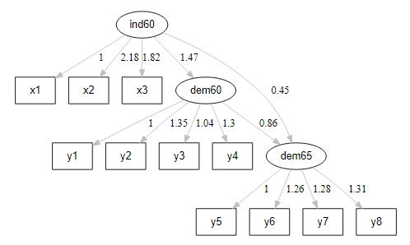
lavaan [3]
y1
Expert ratings of the freedom of the press in 1960
y2
The freedom of political opposition in 1960
y3
The fairness of elections in 1960
y4
The effectiveness of the elected legislature in 1960
y5
Expert ratings of the freedom of the press in 1965
y6
The freedom of political opposition in 1965
y7
The fairness of elections in 1965
y8
The effectiveness of the elected legislature in 1965
x1
The gross national product (GNP) per capita in 1960
x2
The inanimate energy consumption per capita in 1960
x3
The percentage of the labor force in industry in 1960
Latent variables
Measured variables

Slide 7
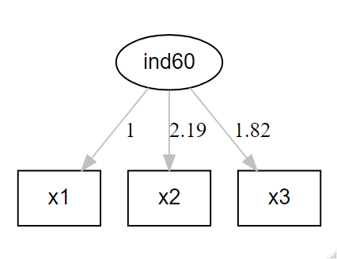
lavaan [4]
model <- '
ind60 =~ x1 + x2 + x3
‘

Slide 8
lavaan [4]
model <- '
ind60 =~ x1 + x2 + x3
‘
model <- '
ind60 =~ x1 + x2 + x3
dem60 =~ y1 + y2 + y3 + y4
'

Slide 9
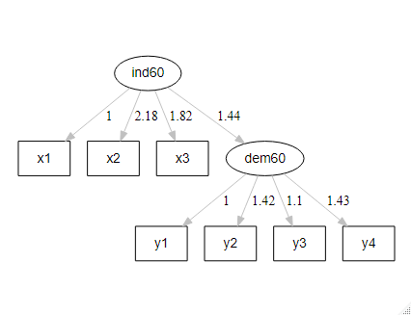
lavaan [4]
model <- '
ind60 =~ x1 + x2 + x3
dem60 =~ y1 + y2 + y3 + y4
dem60 ~ ind60
'

Slide 10
lavaan [5]
model <- '
# measurment model
ind60 =~ x1 + x2 + x3
dem60 =~ y1 + y2 + y3 + y4
dem65 =~ y5 + y6 + y7 + y8
# regressions
dem60 ~ ind60
dem65 ~ ind60 + dem60
'

Slide 11
lavaan [6]
Once defined, you fit the model using a dataset
This is done with the sem() function or cfa() function:
fit <- sem(model, data=PoliticalDemocracy, std.lv=F)
Then, inspect the model using summary() function:
summary(fit, fit.measures=TRUE, standardized= TRUE, rsquare=TRUE, ci=TRUE)

Slide 12
Path analysis
“Mediation analysis” – only currently interested in observed variables
(latent variables come later)
Mediator
(a)
(b)
Exposure
(c)
Outcome
Total effect: (A * B) + C
Mediated effect (indirect effect): A * B
Direct effect: C

Slide 13
Example
Attractiveness to bees
(a)
(b)
Sepal length
(c)
Likelihood of pollination
bee_model <- ' # regressions
attractiveness ~ a*Sepal.Length
pollinated ~ b*attractiveness
pollinated ~ c*Sepal.Length
# indirect effect (a*b)
sepal_attract := a*b
# total effect
total := c + (a*b)
'

Slide 14
Confirmatory factor analysis
Want to understand the psychometric properties of a scale
Example – Andy Field’s “SPSS Anxiety Scale”
Want to evaluate the properties of the “SAQ-8”
Statistics makes me cry
My friends will think I’m stupid for not being able to cope with SPSS
Standard deviations excite me
I dream that Pearson is attacking me with correlation coefficients
I don’t understand statistics
I have little experience of computers
All computers hate me
I have never been good at mathematics

Slide 15
Confirmatory factor analysis
Suppose we believe that 8 items might be sufficient to measure the latent construct “SPSS Anxiety” – can use CFA to test this
Factor loadings – how well each indicator correlates with the latent variable

Slide 16
Model fit statistics
Model chi-square -> the null hypothesis is that the data fits the model, therefore p<0.05 would indicate a bad model fit
This is a sensitive test
CFI – scores between >0.9 seen as “good fit”
TLI – Scores closer to 1 are better fit. CFI and TLI highly correlated
RMSEA (root mean square error of approximation)
<= 0.05 -> “close fit”
0.05-0.08 -> “reasonable fit”
>= 0.10 “poor fit”

Slide 17
Two factor model?
Indicator 2 loaded poorly onto the factor
“My friends will think I’m stupid for not being able to cope with SPSS”
Perhaps this is social anxiety rather than specific to SPSS
Indicators 6 and 7:
I have little experience of computers
All computers hate me
Perhaps these are more representative of a general fear of technology

Slide 18
Two factor model? [2]

Slide 19
Lots more detail here:
https://stats.idre.ucla.edu/r/seminars/rcfa/

Slide 20
Structural Equation Modelling
Bringing path analysis and CFA together
SEM – Path analysis with latent variables
https://stats.idre.ucla.edu/r/seminars/rsem/#s5

Slide 21
Motivating example
A research team want to evaluate the association between student’s adjustment to school life, negative risk factors and school achievement

Slide 22
Motivating example
Parent’s psychology
Risk
SES
Reading
Verbal IQ
School achievement
Arithmetic
Motivation
Adjustment
Spelling
Harm
Stability

Slide 23
More info here
SEM example
https://stats.idre.ucla.edu/r/seminars/rsem/#s5
Additional things I haven’t talked about are:
Exploratory factor analysis (https://cran.r-project.org/web/packages/psychTools/vignettes/factor.pdf)
using categorical variables
latent growth curve modelling
Lavaan tutorials and other material
https://lavaan.ugent.be/

