Slide 1
Progress in Neuromorphic Photonics
Thomas Ferreira de Lima*, Bhavin J. Shastri, Alexander N. Tait, Mitchell A. Nahmias and Paul R. Prucnal
Lightwave Communications Research Laboratory, Department of Electrical Engineering, Princeton University, Princeton, NJ 08544, USA.
Corresponder e-mail: tlima@princeton.edu
Mark Kynigos

Slide 2
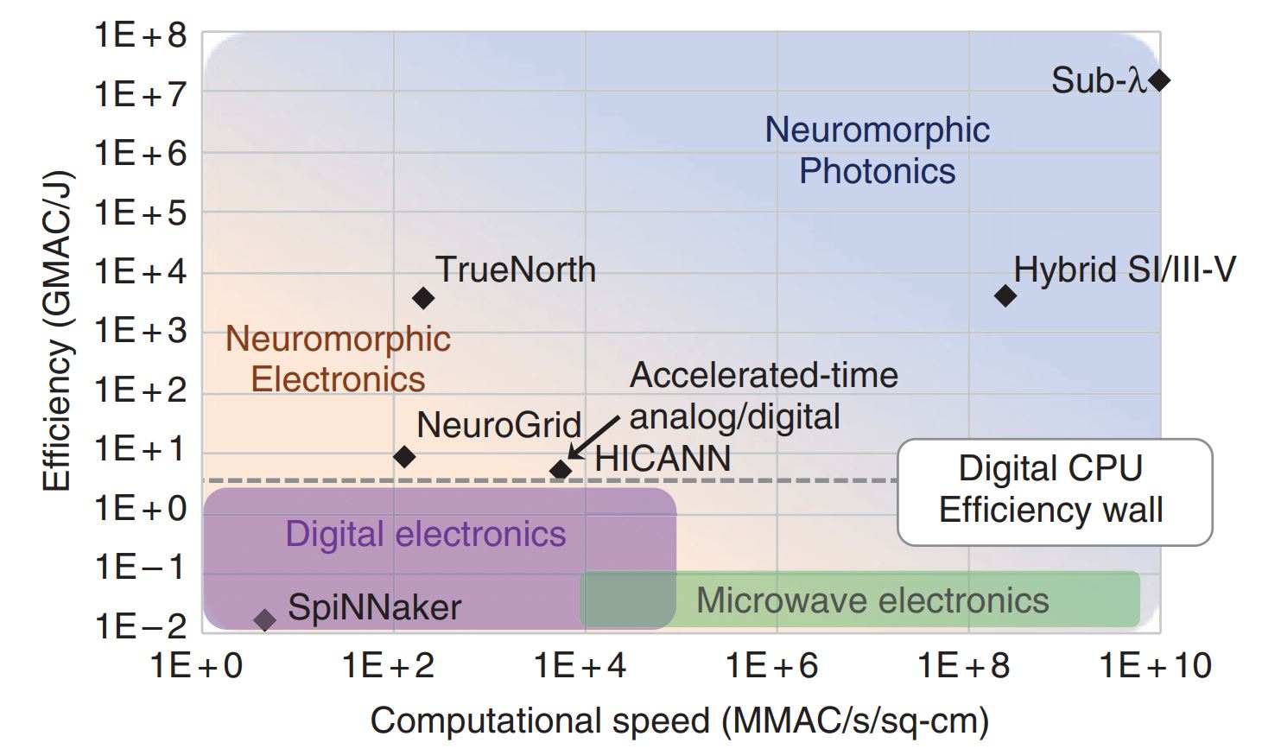
But… Why?
Progress in Neuromorphic Photonics
Why neuromorphic?
Bio-inspired energy efficient specialized co-processors
Estimated human brain computation efficiency: ${10}^{20}$ MAC/s with 20W of power
Limitations in electronics:
Large amount of interconnects (IC)/ multicasting introduces physical performance challenges
Operations per neuron in the kHz- low MHz regime
Mark Kynigos

Slide 3
But… Why?
Progress in Neuromorphic Photonics
Why photonics?
Significantly increased bandwidth density of ICs
Potentially very energy efficient
Relatively distance-independent energy consumption compared to electronics
Limitations:
Requires nascent manufacturing technology (SiPh platforms)
Prone to noise and optical losses
Mark Kynigos

Slide 4
But… Why?
Progress in Neuromorphic Photonics
Why neuromorphic photonics?
Best of both worlds:
energy efficiency through computation model & interconnect
More computational speed through photonic IC for specialised domains ( e.g. Real-time RF processing, QP)
Hybrid SiPh manufacturing platforms
passive & active optical component integration on-chip
Mark Kynigos

Slide 5
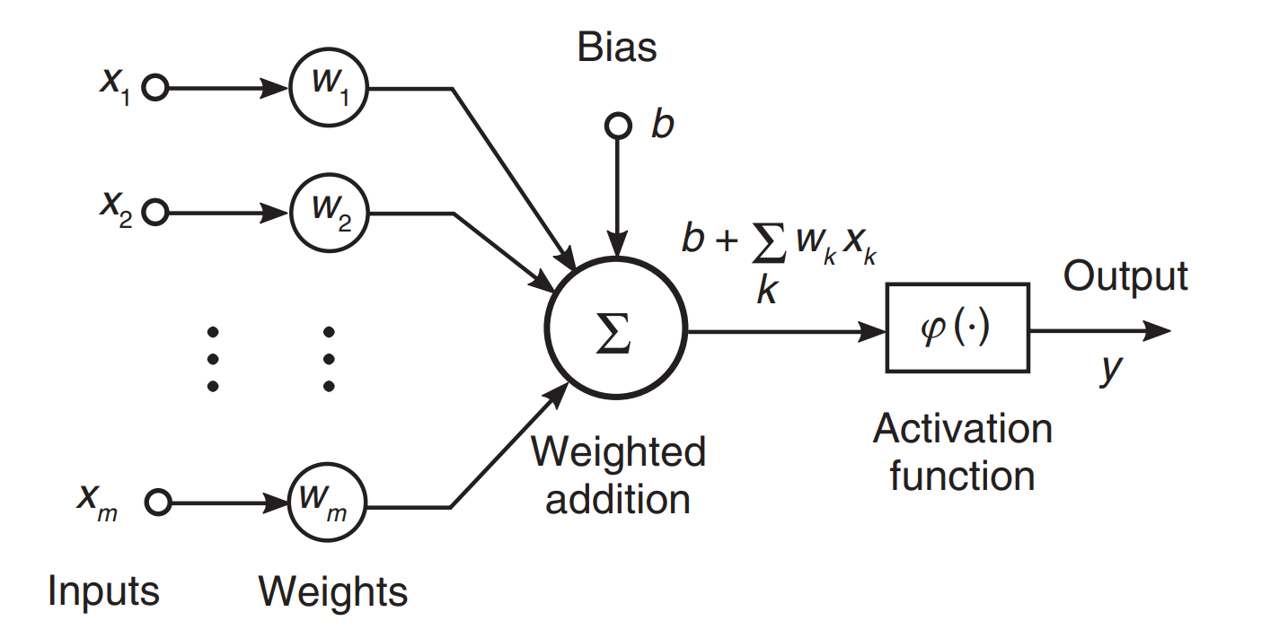
Key Criteria for Nonlinear Elements
Progress in Neuromorphic Photonics
Enabling scalable platforms:
Thresholding
Max. fan-in
Cascadability
“Neuromorphism”:
Isomorphism between artificial NNs and optoelectronic devices
Nonlinearity in individual neurons
Synaptic interconnection
Mark Kynigos

Slide 6
Basic Requirements for Photonic Neurons
Progress in Neuromorphic Photonics
Basic operations:
Vector Multiplication
Spatial summation
Non-linear transformation
Hardware provision:
Signal integrity
Scalable max. fan-in
Enough output power to drive the neighbours (cascadability)
${SNR}_{out}<{SNR}_{in} (thresholding)$
WDM compatibility?
Mark Kynigos

Slide 7
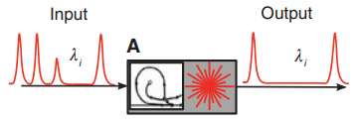
Photonic Network Node (PNN)
Progress in Neuromorphic Photonics
A networkable photonic device with optical I/O that can emulate an artificial neuron
PNN types:
All-optical (Fig. 3A, 3B): Based on excitable lasers
Optical-electrical-optical (O/E/O) (Fig. 3C)
Mark Kynigos

Slide 8
All-optical PNNs: Excitable Lasers
Progress in Neuromorphic Photonics
Excitable system criteria:
there is only one stable state at which the system can indefinitely stay at rest
when excited above a certain threshold, the system undergoes a stereotypical excursion, emitting a “spike”
after the excursion, the system decays back to rest in the course of a “refractory period” during which it is temporarily less likely to emit another spike
Mark Kynigos

Slide 9
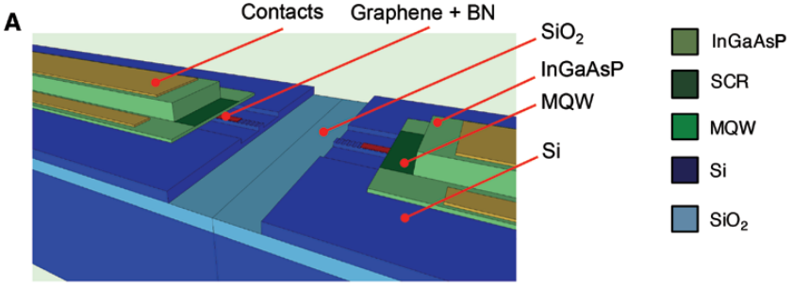
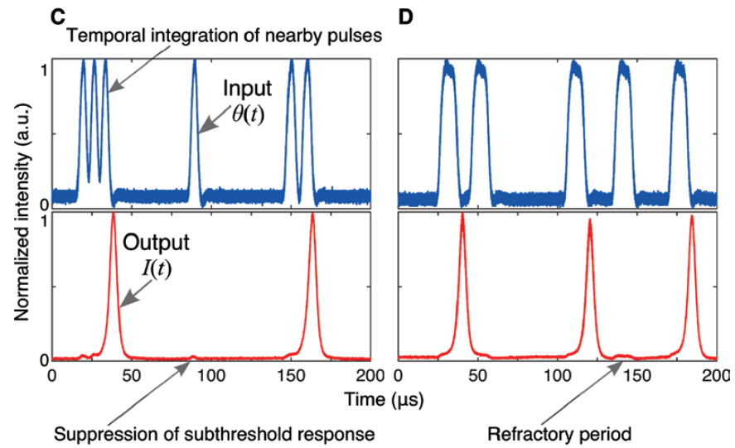
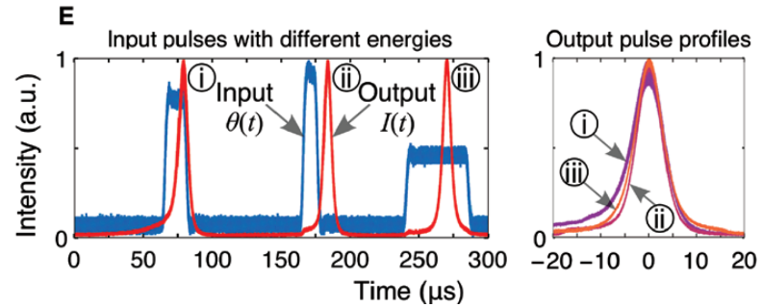
All-optical PNNs: Excitable Graphene Laser
Progress in Neuromorphic Photonics
Mark Kynigos

Slide 10
All-optical PNNs: LIF Analogy
Progress in Neuromorphic Photonics
Near-threshold laser dynamics:
LIF Model:
If $G\left(t\right)>G_{thresh}$, then release a pulse and set $G(t)$ →$G_{reset}$, where $G(t)$models the gain, $γ_{G}$ is the gain carrier relaxation rate, $A$ is the gain bias current. $θ\left(t\right)=\sum_{i}{δ(t−τ_{i})}$is the input for spike firing times $τ_{i}$, $G_{thresh}$is the gain threshold and $G_{reset}≈0$ is the gain at transparency.
If $V_{m}\left(t\right)>V_{thresh}$, then release a spike and set$V_{m}(t)$ →$V_{reset}$, where $V_{m}\left(t\right)$is the membrane voltage, $R_{m}$is the membrane resistance, $V_{L}$ is the equilibrium potential, and $I_{app}$ is the applied current (input).
Mark Kynigos

Slide 11
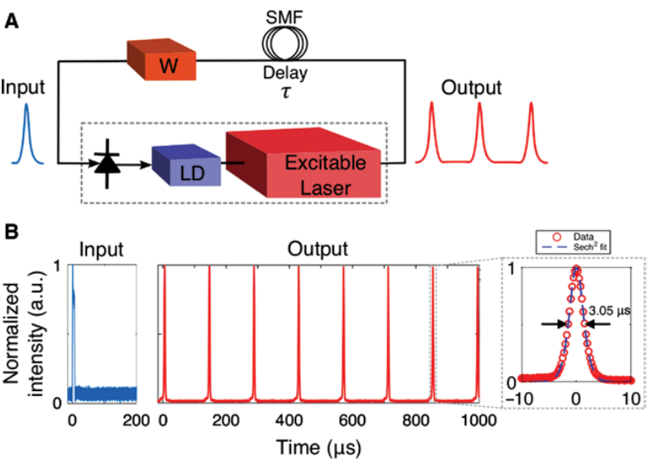
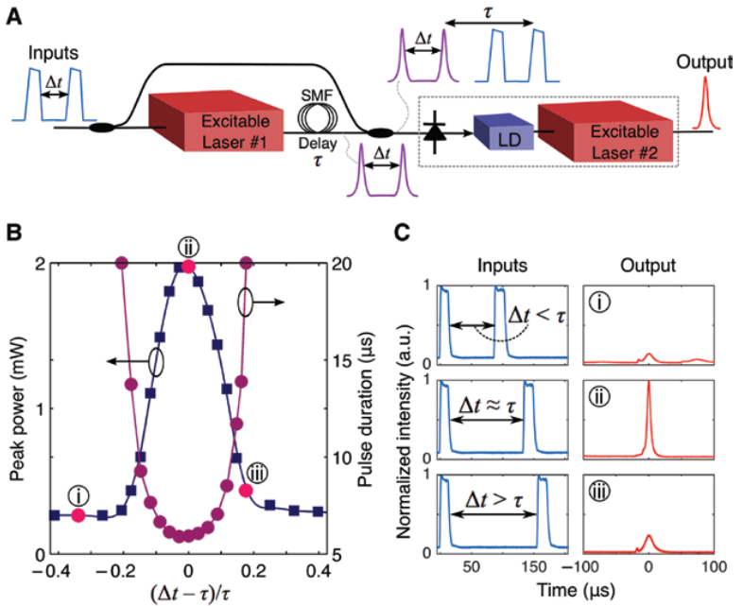
All-optical PNNs: Excitable Laser Circuits
Progress in Neuromorphic Photonics
Cascadability
Temporal Pattern Recognition
Mark Kynigos

Slide 12
O/E/O PNNs: Breakdown
Progress in Neuromorphic Photonics
E/O sub-circuit: non-linear component
Electronic input (weighted sum of optical inputs)
Perform dynamic or nonlinear process
Generate a clean optical output on a single wavelength
O/E sub-circuit: weighted addition
Protocol?
Hardware?
Use WDM for scalability?
O/E WDM weighted addition
E/O non-linearity
Mark Kynigos

Slide 13
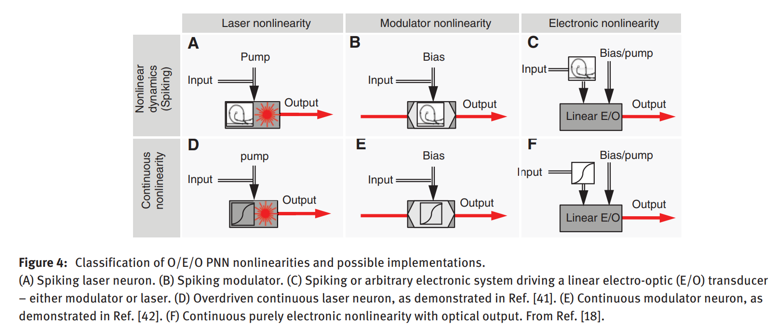
O/E/O PNNs: E/O Nonlinearity Generation
Progress in Neuromorphic Photonics
Ultrafast modulator not demonstrated
Need to operate slow enough for output digitization
Most promise, nascent tech.
On-chip lasers generate energy savings but contribute to power env.
Off-chip lasers well understood, less energy efficiency and coupling probs.
Same as C
Mark Kynigos

Slide 14
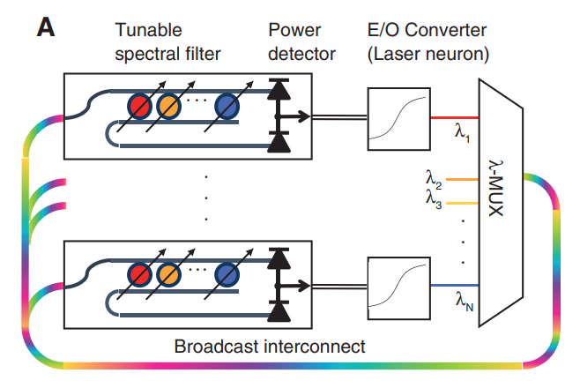
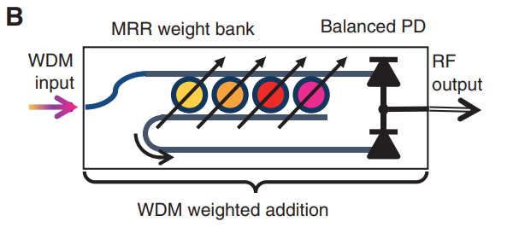
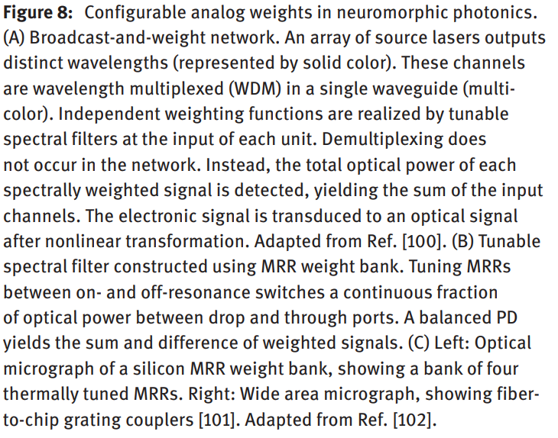
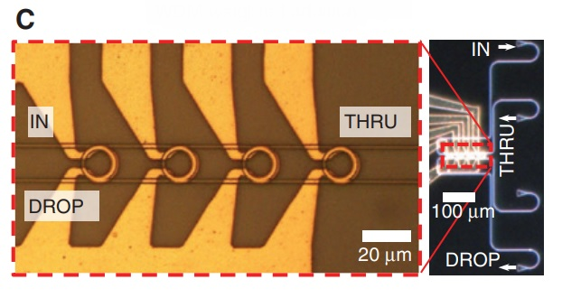
PNN Network Architecture: O/E Component
Progress in Neuromorphic Photonics
Protocol: Broadcast-and-weight
Similar to fibre telecom “Broadcast and Select”
WDM input fed to MRR weight bank which performs weighted add
Mark Kynigos

Slide 15
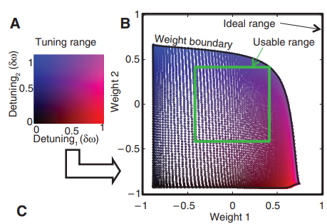
PNN Network Architecture: Weight bank limits
Progress in Neuromorphic Photonics
Weight bank controllers limited by thermal crosstalk handling
Each wavelength corresponds to a heating level at the MRR tuner heat affects neighbours
Non-ideal fabrication-isolation reduces the weight range
Channel limits:
Depending on MRR type, between 108-334 channels
Limits connectivity scaling (max. fan-in)
Mark Kynigos

Slide 16
Scaling solutions:
Progress in Neuromorphic Photonics
Spectrum reuse strategies
Exploiting interference in MRR weight banks
More degrees of freedom in multiplexing (mode division, polarization division)
Mark Kynigos

Slide 17
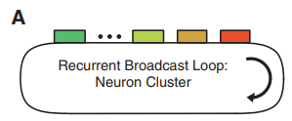
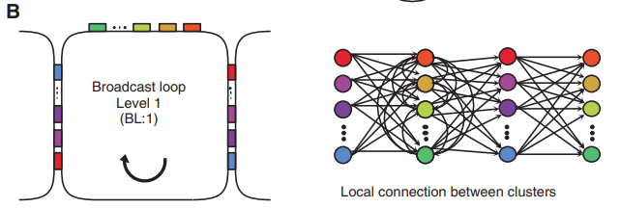
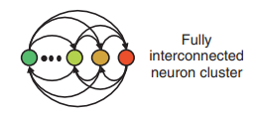
Scaling solutions: Spectrum reuse
Progress in Neuromorphic Photonics
Mark Kynigos

Slide 18
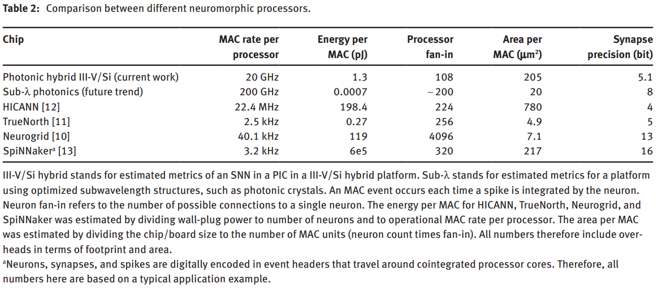
Neuromorphic Platform Comparison
Progress in Neuromorphic Photonics
Mark Kynigos

Slide 19
Neuromorphic Photonic proc. Applications (1)
Progress in Neuromorphic Photonics
Real-time RF processing, massive MIMO systems
Most radio transceiver systems are processed by DSPs or FPGAs
Carrier signal throughput (GHz range) is limited by processor speeds
Sampling-parallelisation helps at the cost of more latency/energy overhead
ASICs are expensive/not reconfigurable
Use Neuromorphic Photonic hardware for dimensionality reduction tasks (PCA, blind-source separation)
Mark Kynigos

Slide 20
Neuromorphic Photonic proc. Applications (2)
Progress in Neuromorphic Photonics
Nonlinear programming, QP
Model predictive control problem can be reduced to a QP problem
MPC is successfully used in “slow” processes, i.e. sufficient time for solving the optimization problem between sampling instants.
Applying MPC to faster systems requires faster QP solving
QP can be mapped onto recurrent neural networks
Neuromorphic Photonic hardware offers low ToF for communication, which somehow means less latency.
Mark Kynigos

Slide 21
Paper Critique
Progress in Neuromorphic Photonics
Pros
Cons
Good overview of current research efforts
Well written, good narrative, digestible
Nice trade-off analysis for photonic weight banks
Application section
Written for photonics engineers
Very focused on thermally tuned MRRs for weight banks, no talk of other devices (e.g. AWGRs, E/O MRRs)
Not enough focus on comm. protocols, WDM schemes
Seems like a lot of assumptions for platform comparison
Mark Kynigos

Slide 22
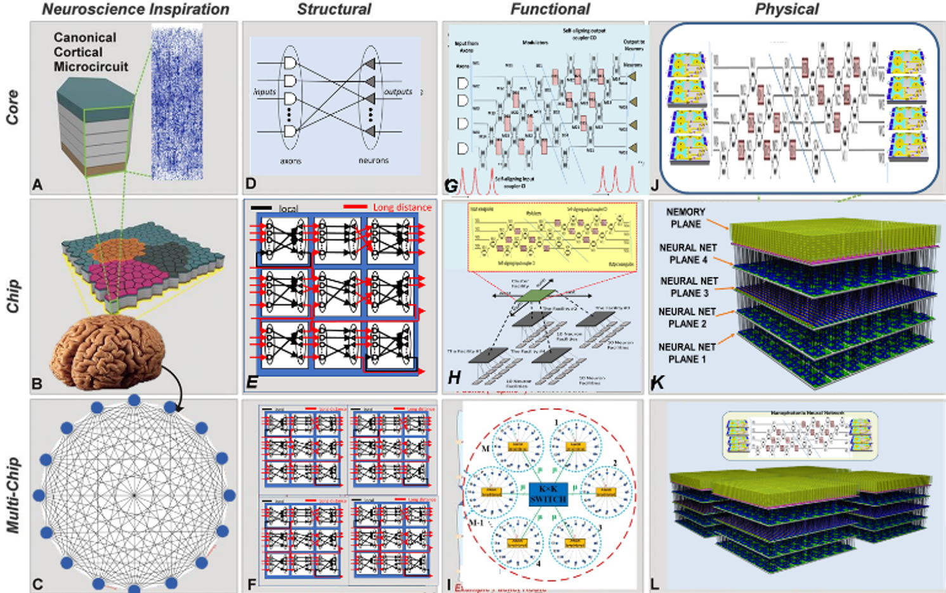
Supplementary: 3D Integrated Nanophotonic Neuromorphic Computing @ UC Davis
Progress in Neuromorphic Photonics
Info at:
https://sierra.ece.ucdavis.edu/index.php/2020/03/21/neuromorphic-computing-with-3d-integrated-nanophotonic-neurons/
https://sc17.supercomputing.org/SC17%20Archive/tech_poster/poster_files/post272s2-file2.pdf
Mark Kynigos

Slide 23
Thank you!
Progress in Neuromorphic Photonics

