Slide 1
Residuated Completely Simple Semigroups
G. A. Pinto
The College of The Bahamas
University of York, 14 January 2015

Slide 2
Residuated Completely Simple Semigroups
(1) An ordered semigroup S is a semigroup together with a compatible order. That is, for x, y, z in a semigroup S,
(2) A semigroup S is called completely simple if it is simple (no proper ideals) and if it contains a primitive idempotent (minimal within the set of all idempotents of S)
(3) An ordered semigroup S is called residuated if for any x, y in S, there exists
and
these being, respectively, the left and right residual of x by y.
G. A. Pinto The College of The Bahamas
2

Slide 3
Residuated Completely Simple Semigroups
Theorem [Suschkewitz (1928) and Rees (1940)]
Let G be a group, let I, be non-empty sets and let be a matrix with entries in G. Let
and define a multiplication on S by
Then S is a completely simple semigroup.
Conversely, every completely simple semigroup is isomorphic to a semigroup constructed in this way.
G. A. Pinto The College of The Bahamas
3

Slide 4
Residuated Completely Simple Semigroups
We introduced [Blyth and GAP, 2001] six orders in a completely simple semigroup of the form
where is a totally ordered cyclic group such that .
Take and these sets being ordered in the usual way. Moreover, since we can choose and fix
G. A. Pinto The College of The Bahamas
4

Slide 5
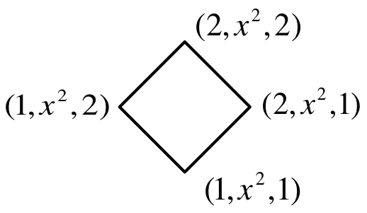
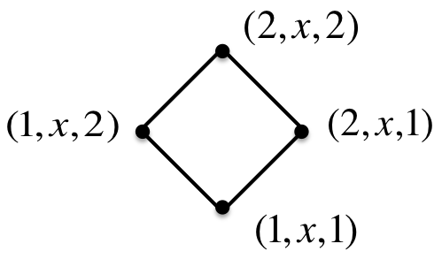
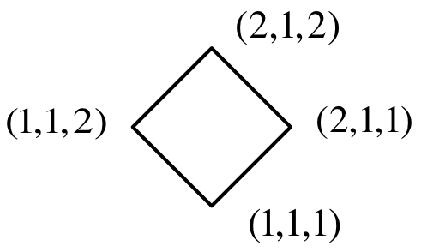
Residuated Completely Simple Semigroups
(a) Lexicographic order,
See the special case where
G. A. Pinto The College of The Bahamas
5

Slide 6
Residuated Completely Simple Semigroups
(b) Left lexicographic order,
See the special case where
G. A. Pinto The College of The Bahamas
6

Slide 7
Residuated Completely Simple Semigroups
(c) Right lexicographic order,
See the special case where
G. A. Pinto The College of The Bahamas
7

Slide 8
Residuated Completely Simple Semigroups
(d) Bootlace order, , which is the transitive closure of
Since and commute, we have that and
See the special case where
G. A. Pinto The College of The Bahamas
8

Slide 9
Residuated Completely Simple Semigroups
(e) Cartesian order,
See the special case where
G. A. Pinto The College of The Bahamas
9

Slide 10
Residuated Completely Simple Semigroups
(f) Discrete Lexicographic order,
See the special case where
G. A. Pinto The College of The Bahamas
10

Slide 11
Residuated Completely Simple Semigroups
The following Hasse diagram indicates the hierarchy of these orders
G. A. Pinto The College of The Bahamas
11

Slide 12
Residuated Completely Simple Semigroups
An important question is:
when each of this orders is compatible with multiplication?
To answer to this question one notion is necessary:
the matrix P is said to be isotone if
whenever and .
G. A. Pinto The College of The Bahamas
12

Slide 13
Residuated Completely Simple Semigroups
Theorem [Blyth and GAP, 2001]
If is totally ordered with , then compatibility occurs if and only if, for
(1) : P is isotone
(2) : P is isotone and
(3) : P is isotone and
(4) : P is isotone and
(5) :
If is discretely ordered then all of the orders coincide with
and P is a constant matrix.
G. A. Pinto The College of The Bahamas
13

Slide 14
Residuated Completely Simple Semigroups
Theorem [Blyth and GAP, 2014]
None of the ordered semigroups
is residuated.
Theorem [Blyth and GAP, 2014]
The ordered semigroup is orthodox and residuated.
The case of the bootlace order, is considerably more complicated. Some crucial observations concerning the structure of P are necessary.
G. A. Pinto The College of The Bahamas
14

Slide 15
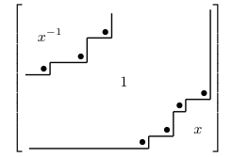
Residuated Completely Simple Semigroups
Theorem [Blyth and GAP, 2014]
The bootlace order is compatible with multiplication on
if and only if the sandwich matrix P is isotone with each row and column containing either at most the elements and 1, or at most the elements 1 and x.
G. A. Pinto The College of The Bahamas
15

Slide 16
Residuated Completely Simple Semigroups
The “stairstep corner” positions, which are illustrated by “dots” on the matrix are of particular significance.
Since each row and each column of P contains at most two distinct entries, there can be at most one row and at most one column that contain two stairstep corner positions.
Such a row [column] will be called exceptional.
Clearly, in an exceptional row [column] the entry 1 involved must be in the last column [row].
G. A. Pinto The College of The Bahamas
16

Slide 17
Residuated Completely Simple Semigroups
For every and we define
and
With this notation, is a stairstep corner entry if and only if
and
Note also that if is a stairstep corner entry then .
G. A. Pinto The College of The Bahamas
17

Slide 18
Residuated Completely Simple Semigroups
Theorem [Blyth and GAP, 2014]
The ordered semigroup is residuated.
The formulae for the residuals are as follows:
G. A. Pinto The College of The Bahamas
18

Slide 19
Residuated Completely Simple Semigroups
Let us now turn our attention to identify on the matrix P the maximal idempotents of these semigroups.
G. A. Pinto The College of The Bahamas
19

Slide 20
Residuated Completely Simple Semigroups
Definition An entry of P will be called prime if
and
It follows from this definition that if a stairstep corner entry is the only one in its row and its column then it is prime.
If an exceptional row (column) exists then the corner entry 1 in the last row (column) is not prime.
Theorem [Blyth and GAP, 2014]
In the following statements are equivalent:
(1) is a maximal idempotent;
(2) is a prime stairstep corner entry of P.
G. A. Pinto The College of The Bahamas
20

Slide 21
Residuated Completely Simple Semigroups
Example
The stairstep corner entries are .. All except
are prime, so this semigroup has three maximal
idempotents.
G. A. Pinto The College of The Bahamas
21

Slide 22
Residuated Completely Simple Semigroups
Definition A residuated regular semigroup is said to be concise if all idempotents of the form
and
are maximal.
Theorem [Blyth and GAP, 2014]
is concise if and only if the sandwich matrix P is symmetric and each row [column] has a prime corner entry.
Corollary [Blyth and GAP, 2014]
is concise if and only if P is of size and has n maximal idempotents.
G. A. Pinto The College of The Bahamas
22

Slide 23
Residuated Completely Simple Semigroups
Example
The sandwich matrices with concise are
G. A. Pinto The College of The Bahamas
23

Slide 24
Residuated Completely Simple Semigroups
When has a biggest idempotent?
Theorem [Blyth and GAP, 2014]
The following statements are equivalent:
(1) has a biggest idempotent
(2) in the sandwich matrix each is either or
(3) in the sandwich matrix each is either or
(4) is orthodox
(5)
G. A. Pinto The College of The Bahamas
24

Slide 25
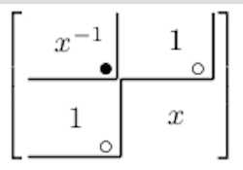
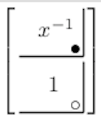
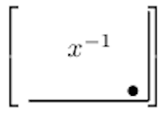
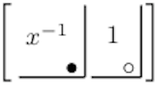
Residuated Completely Simple Semigroups
G. A. Pinto The College of The Bahamas
25

Slide 26
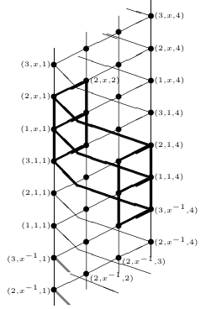
Residuated Completely Simple Semigroups
Example
G. A. Pinto The College of The Bahamas
26

Slide 27
Residuated Completely Simple Semigroups
Order Isomorphism
Theorem [Blyth and GAP, 2014]
For given I and there is, to within ordered semigroup isomorphism, a unique bootlace-ordered orthodox completely simple semigroup of the form
G. A. Pinto The College of The Bahamas
27

Slide 28
Residuated Completely Simple Semigroups
G. A. Pinto The College of The Bahamas
28

Slide 29
Residuated Completely Simple Semigroups
G. A. Pinto The College of The Bahamas
29

Slide 30
Residuated Completely Simple Semigroups
G. A. Pinto The College of The Bahamas
30

Slide 31
Residuated Completely Simple Semigroups
Consider as an example with
sandwich matrix
G. A. Pinto The College of The Bahamas
31

Slide 32
Residuated Completely Simple Semigroups
Sketch of the proof:
Let be orthodox and consider
where K is the matrix all of
whose elements are . Clearly, is orthodox.
Let us define the mapping
given by
G. A. Pinto The College of The Bahamas
32

Slide 33
Residuated Completely Simple Semigroups
QUESTIONS:
1 – The concise semigroup with n maximal idempotents
is unique up to an order isomorphism?
In the case where the matrix P is of order 3, this is true.
2 – What about the non-orthodox and non-concise case?
G. A. Pinto The College of The Bahamas
33

